Slide 1
AWS Marketplace
Lecturer: Ngo Huy Bien
Software Engineering Department
Faculty of Information Technology
University of Science
Ho Chi Minh City, Vietnam
nhbien@fit.hcmus.edu.vn

Slide 2

Objectives
To create an AMI.
To publish an AMI to AWS Marketplace.

Slide 3

Contents
AWS Marketplace.
AMI Creation.
PAYG Server Product.
BYOL Server Product.

Slide 4

References

Slide 5
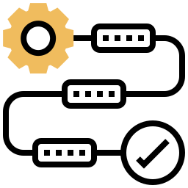
Process for Updating Product

Slide 6
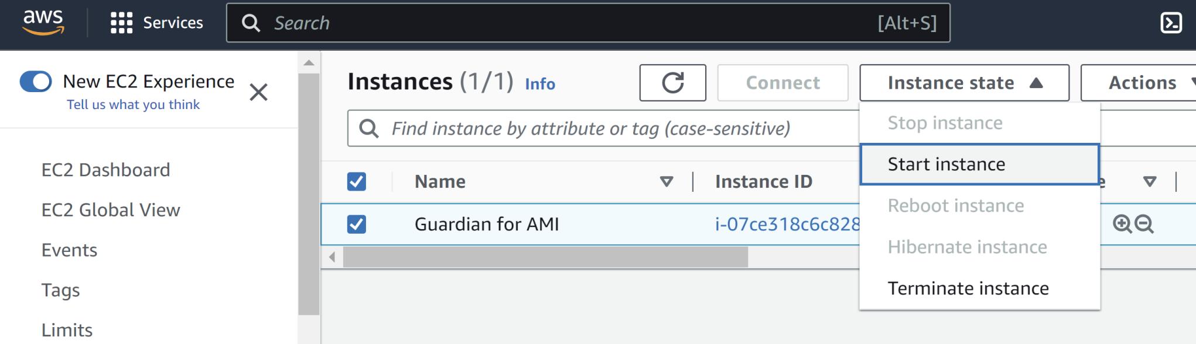
1. Start Original Instance

Slide 7
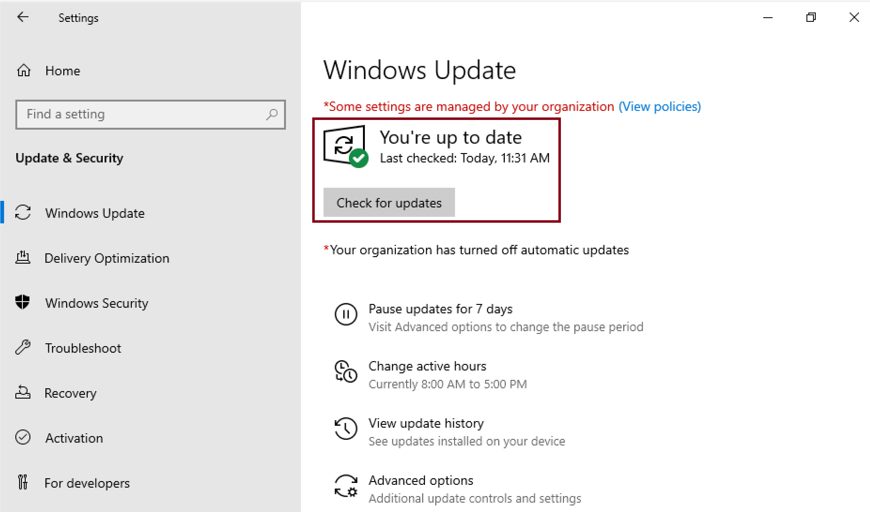
2. Apply Windows Updates

Slide 8
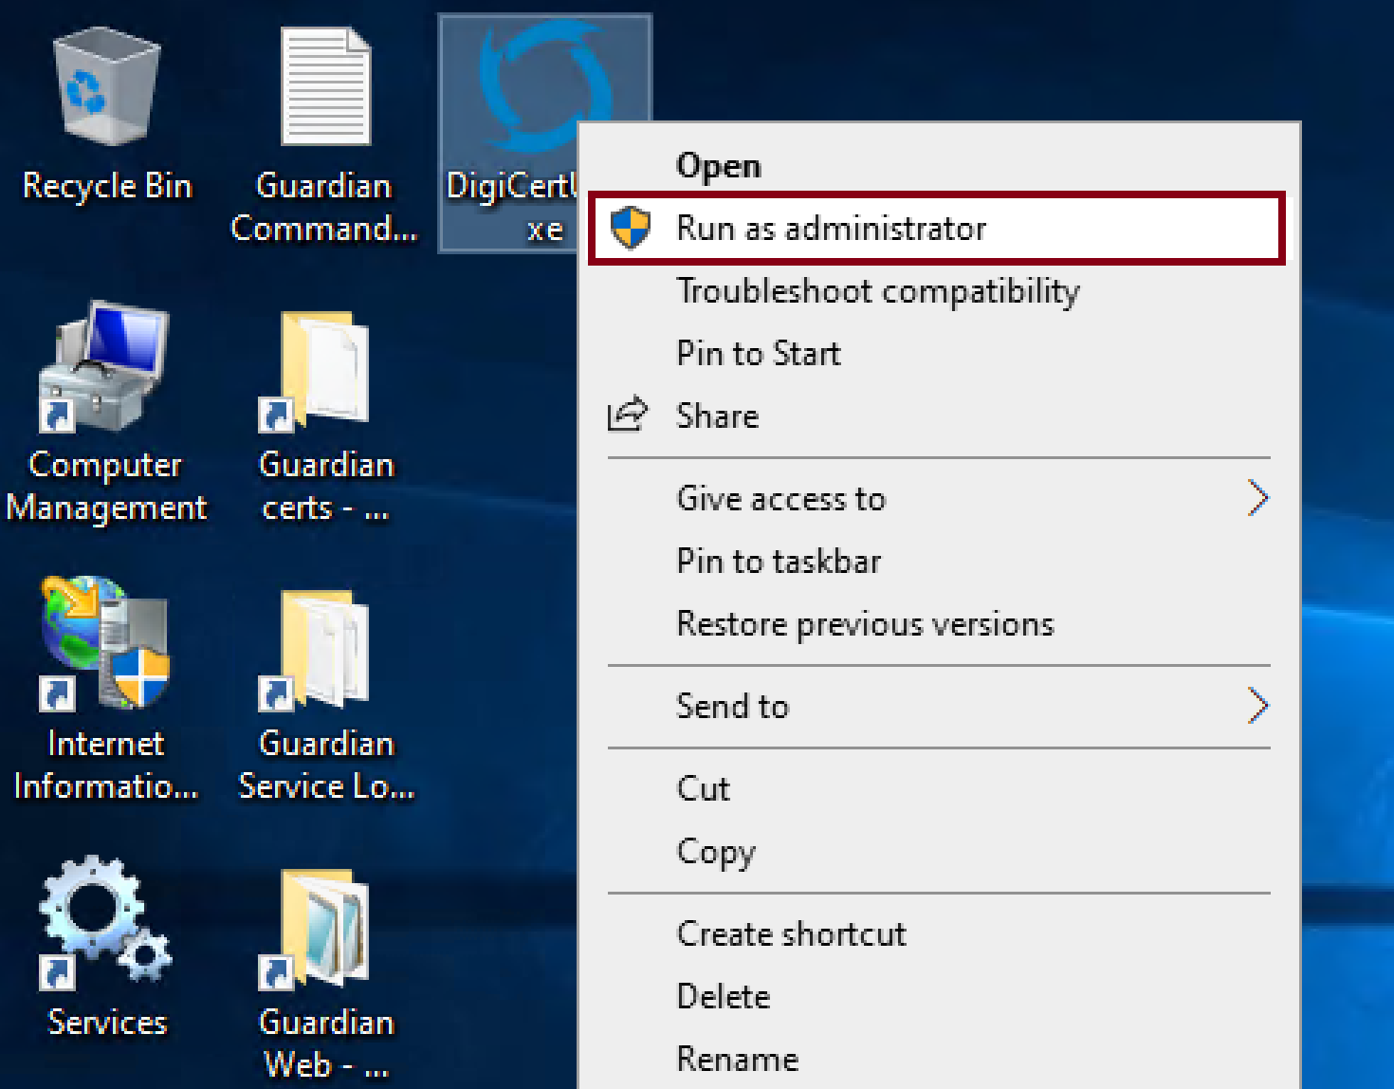
3. Open DigiCert Utility
Run as administrator.

Slide 9
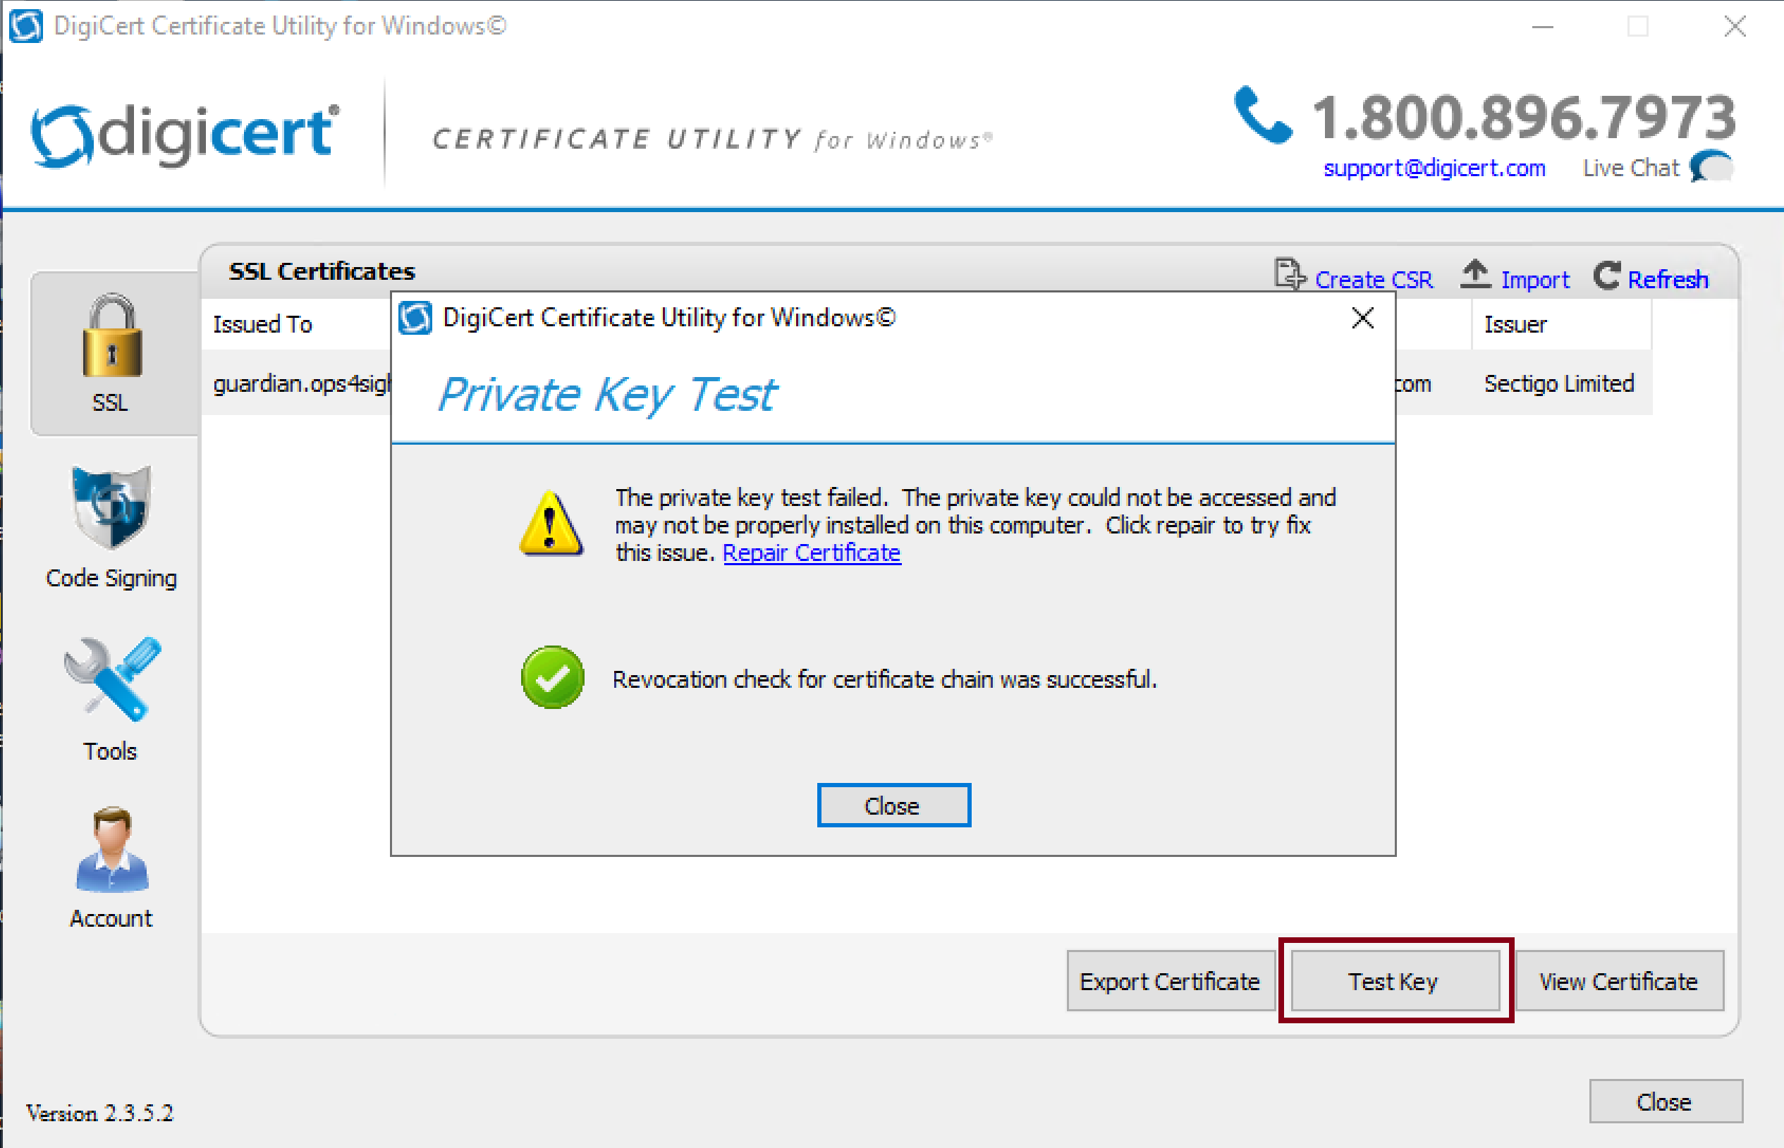
4. Test the Existing Certificate

Slide 10
5. Delete then Import the Cert

Slide 11
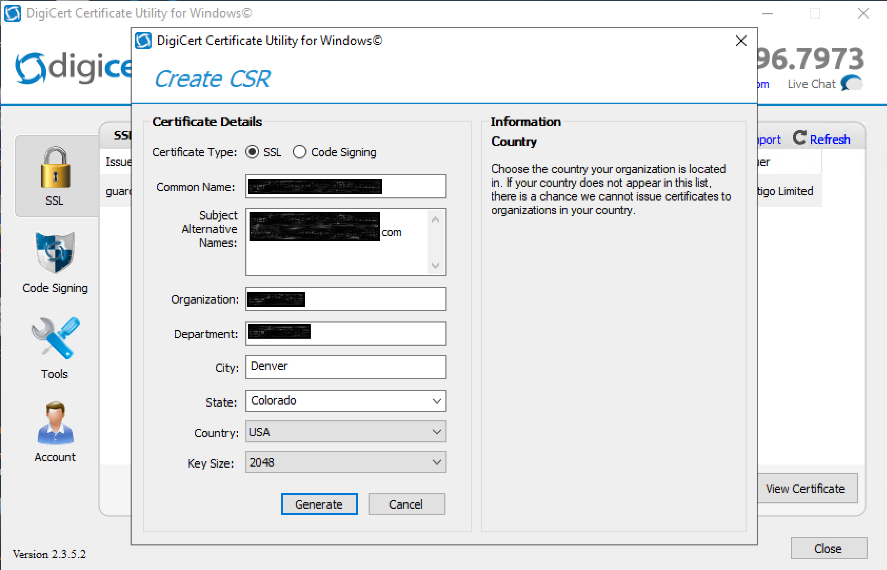
6. Generate a CSR if Necessary

Slide 12
7. Upgrade Web Code if Necessary
Go to D:\deSABRAN\NCM5\Certifient\AWS Marketplace AMIs\PAYG Codebase
Go to D:\deSABRAN\NCM5\Certifient\AWS Marketplace AMIs\BYOL Codebase

Slide 13
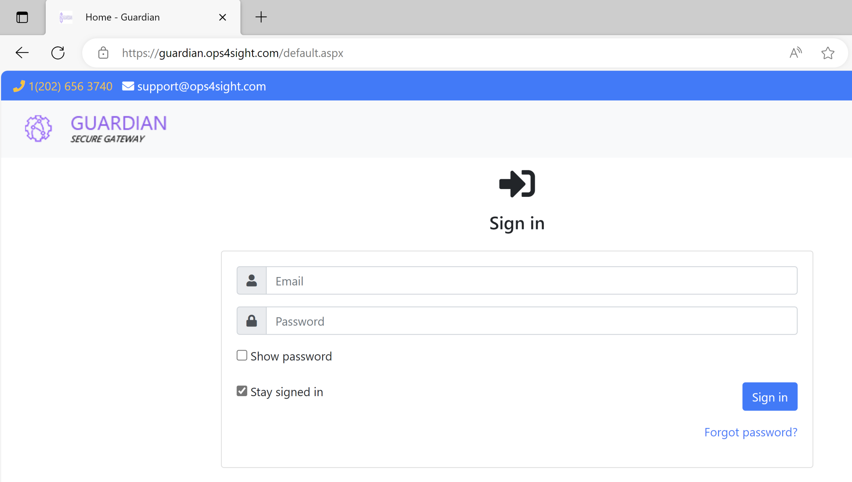
8. Open the Portal
https://guardian.ops4sight.com/

Slide 14
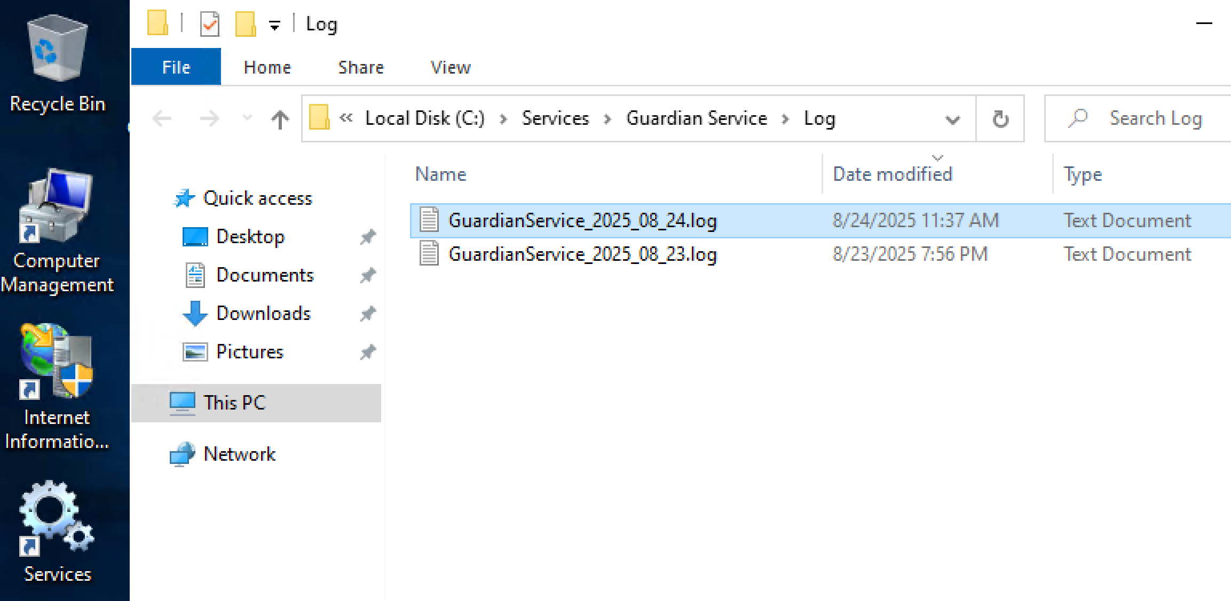
9. Delete Log Files if Necessary

Slide 15
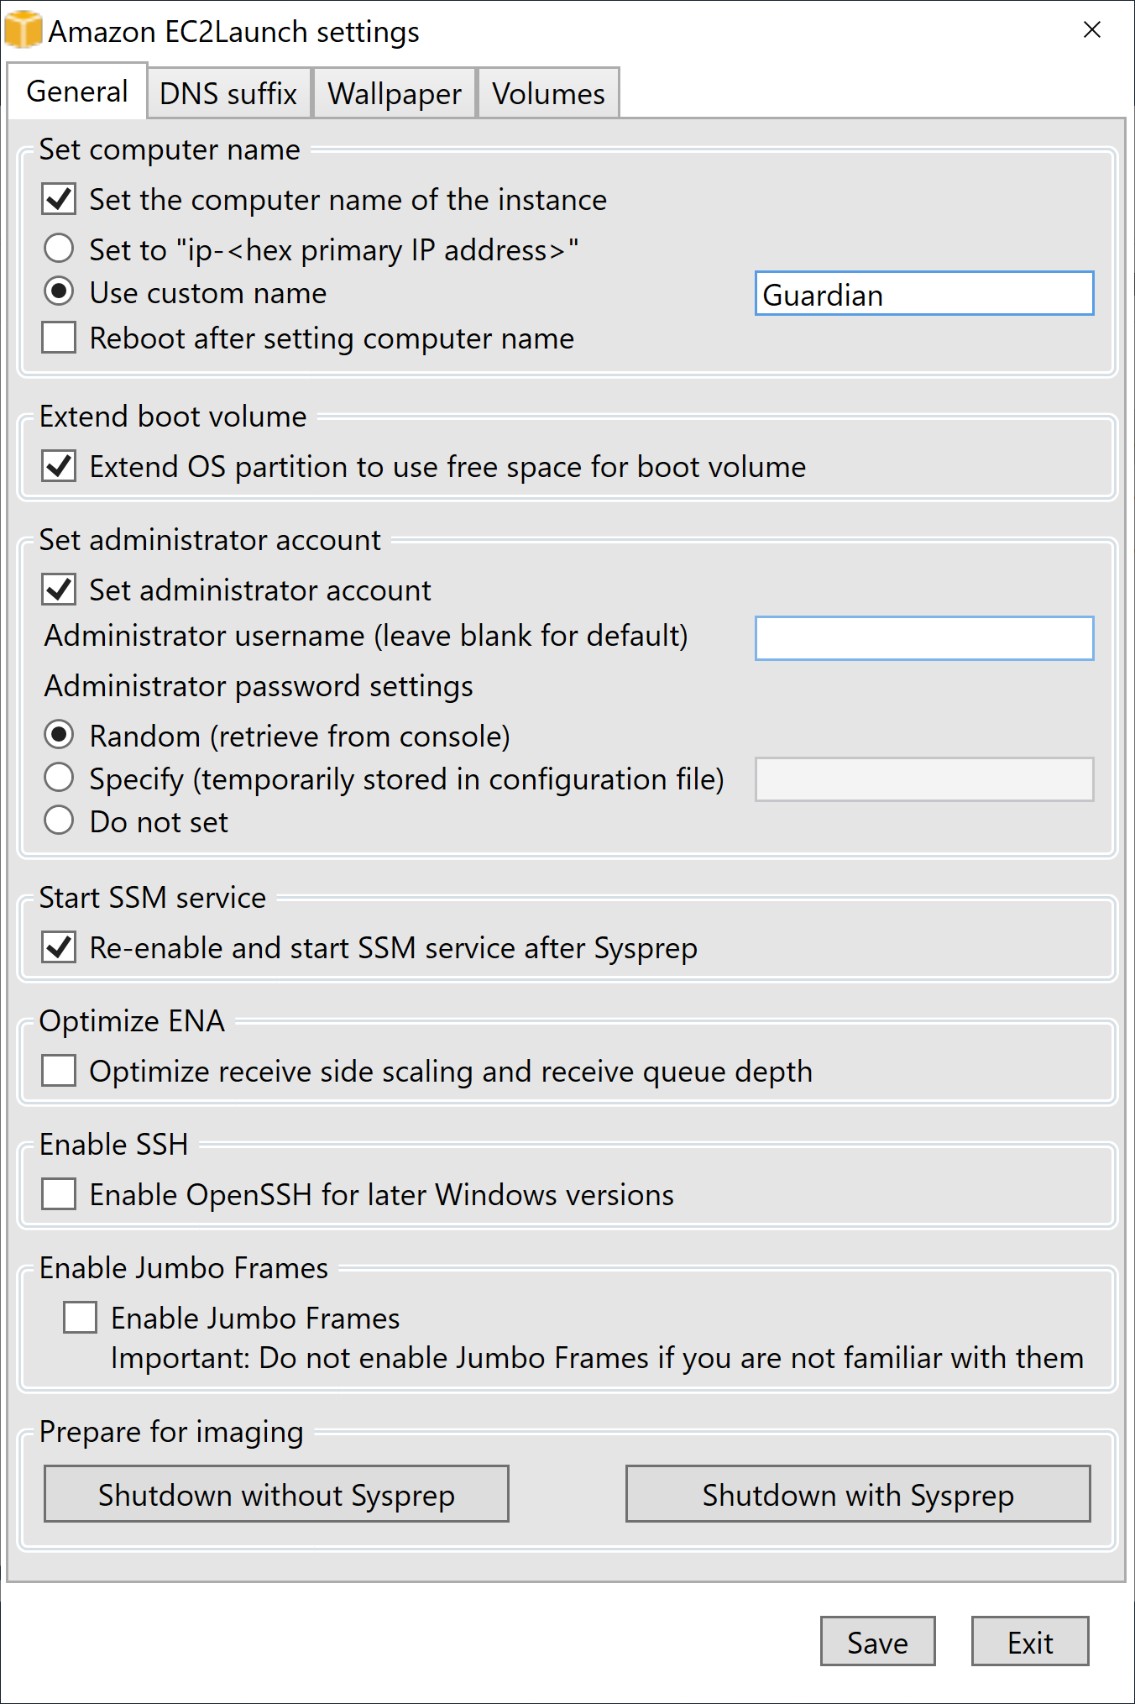
10. Prepare VM for Creating AMI
Go to C:\Program Files\Amazon\EC2Launch\settings
Open EC2LaunchSettings.exe
Enter custom name.
Select Random (retrieve from console).
Click Save button.
Click Shutdown with Sysprep buton.
Sysprep sets a blank password for the built-in administrator account.
Use the admin account or AWS Get Windows password to access the VM after Sysprep is run.

Slide 16
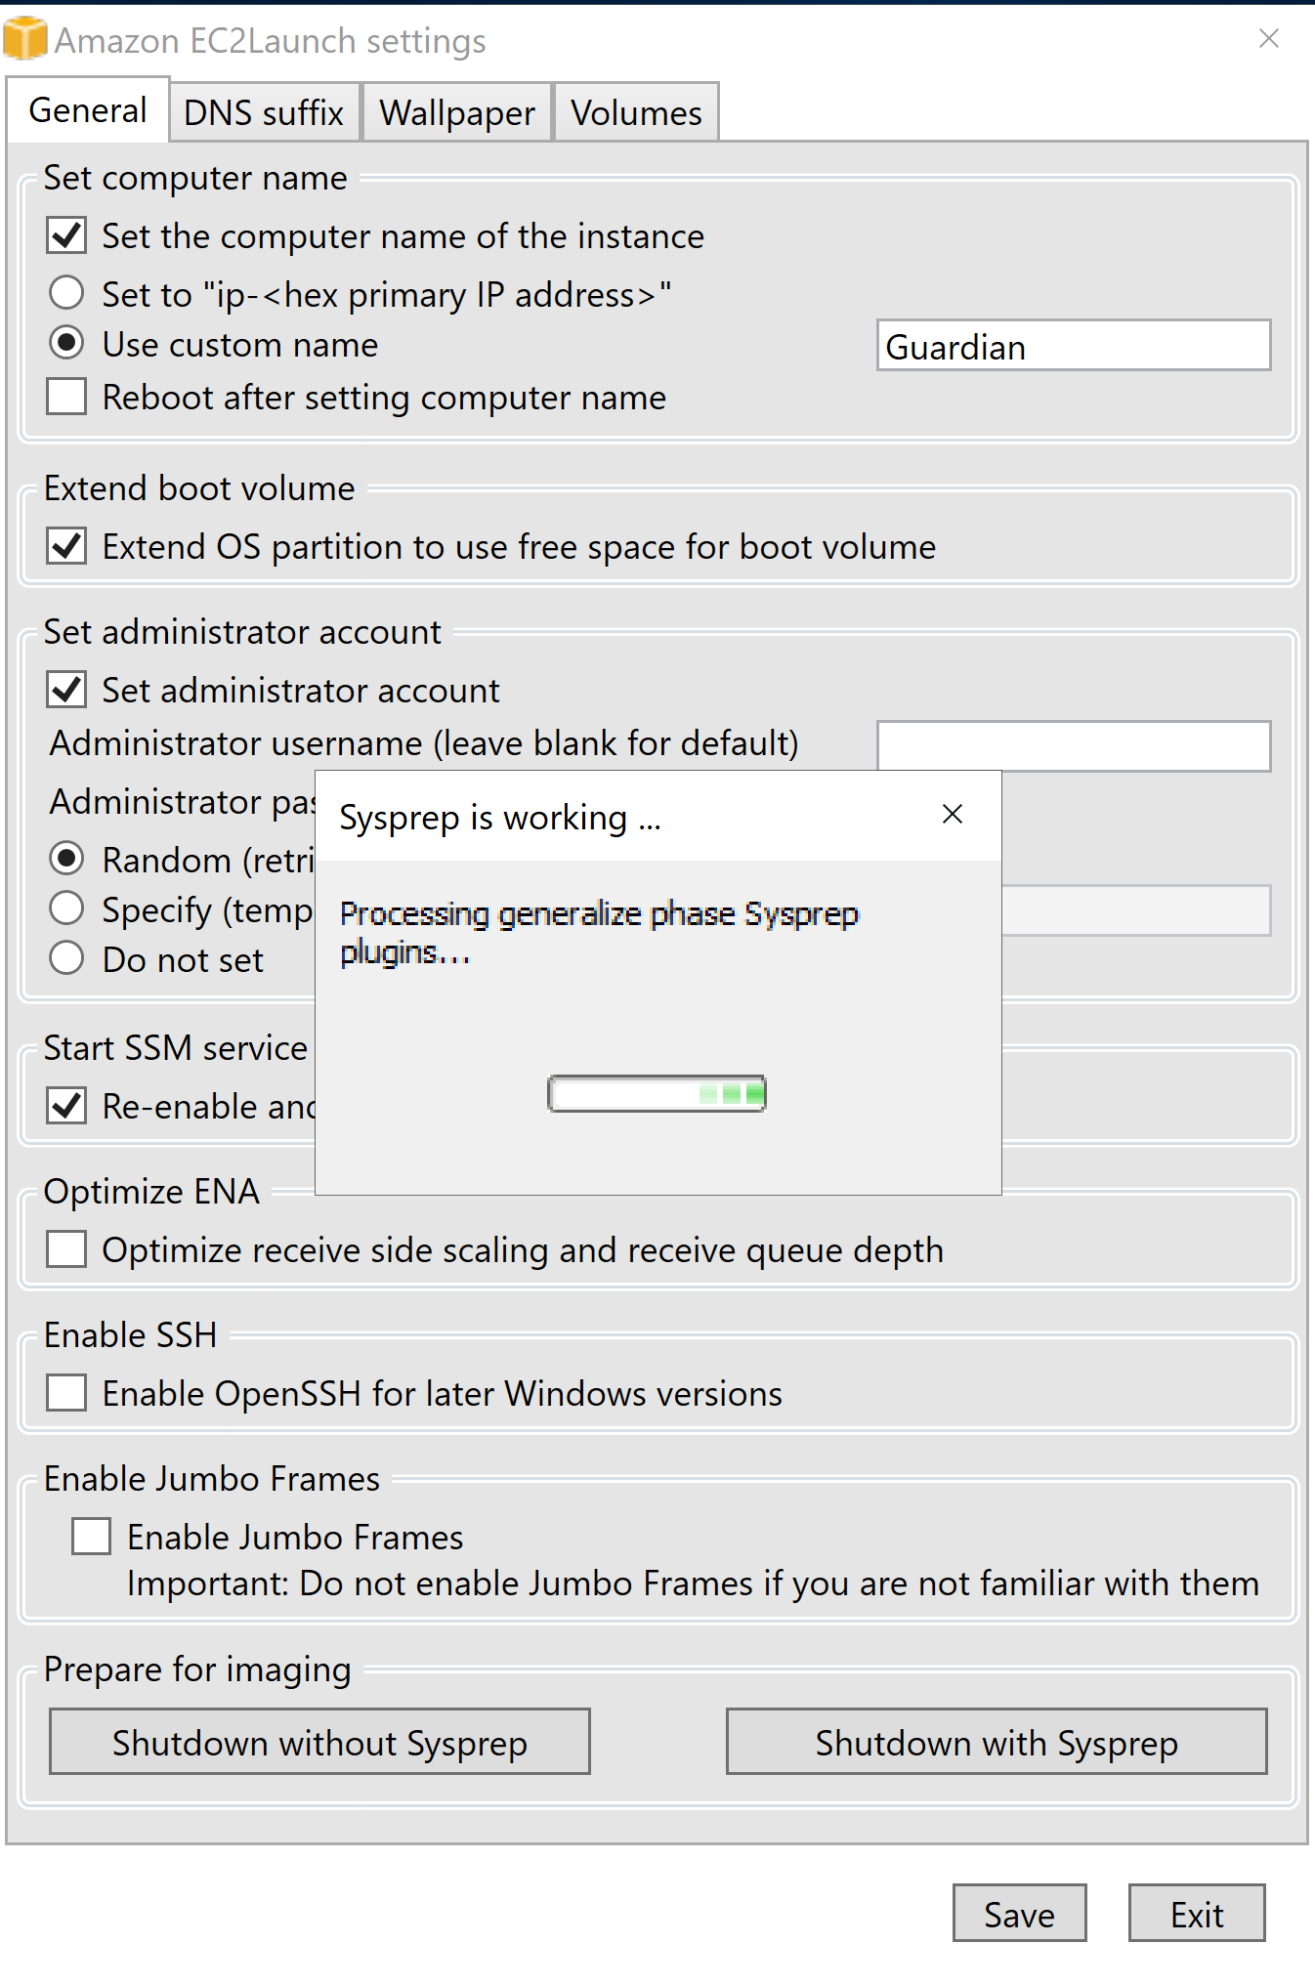
10. Wait until the VM is Shut Down

Slide 17
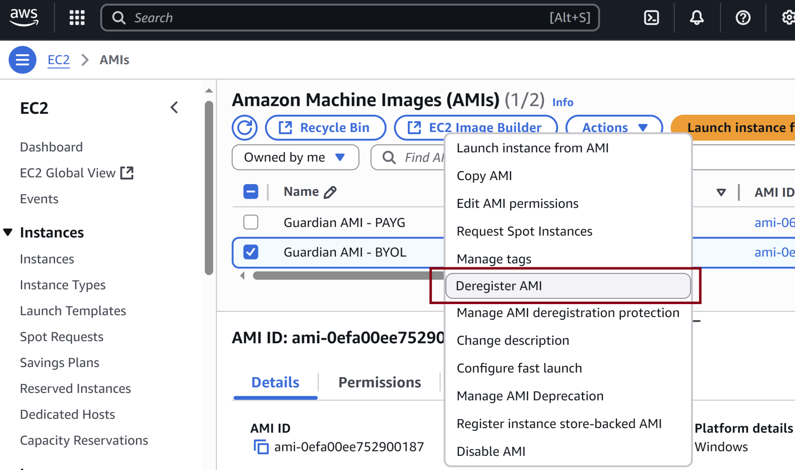
11. Deregister the Existing AMI

Slide 18
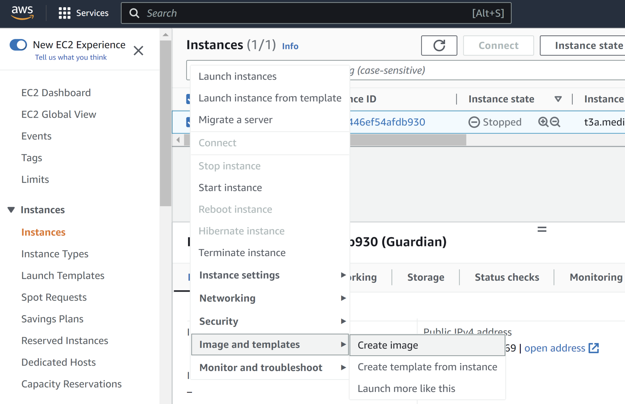
12. Create an AMI

Slide 19
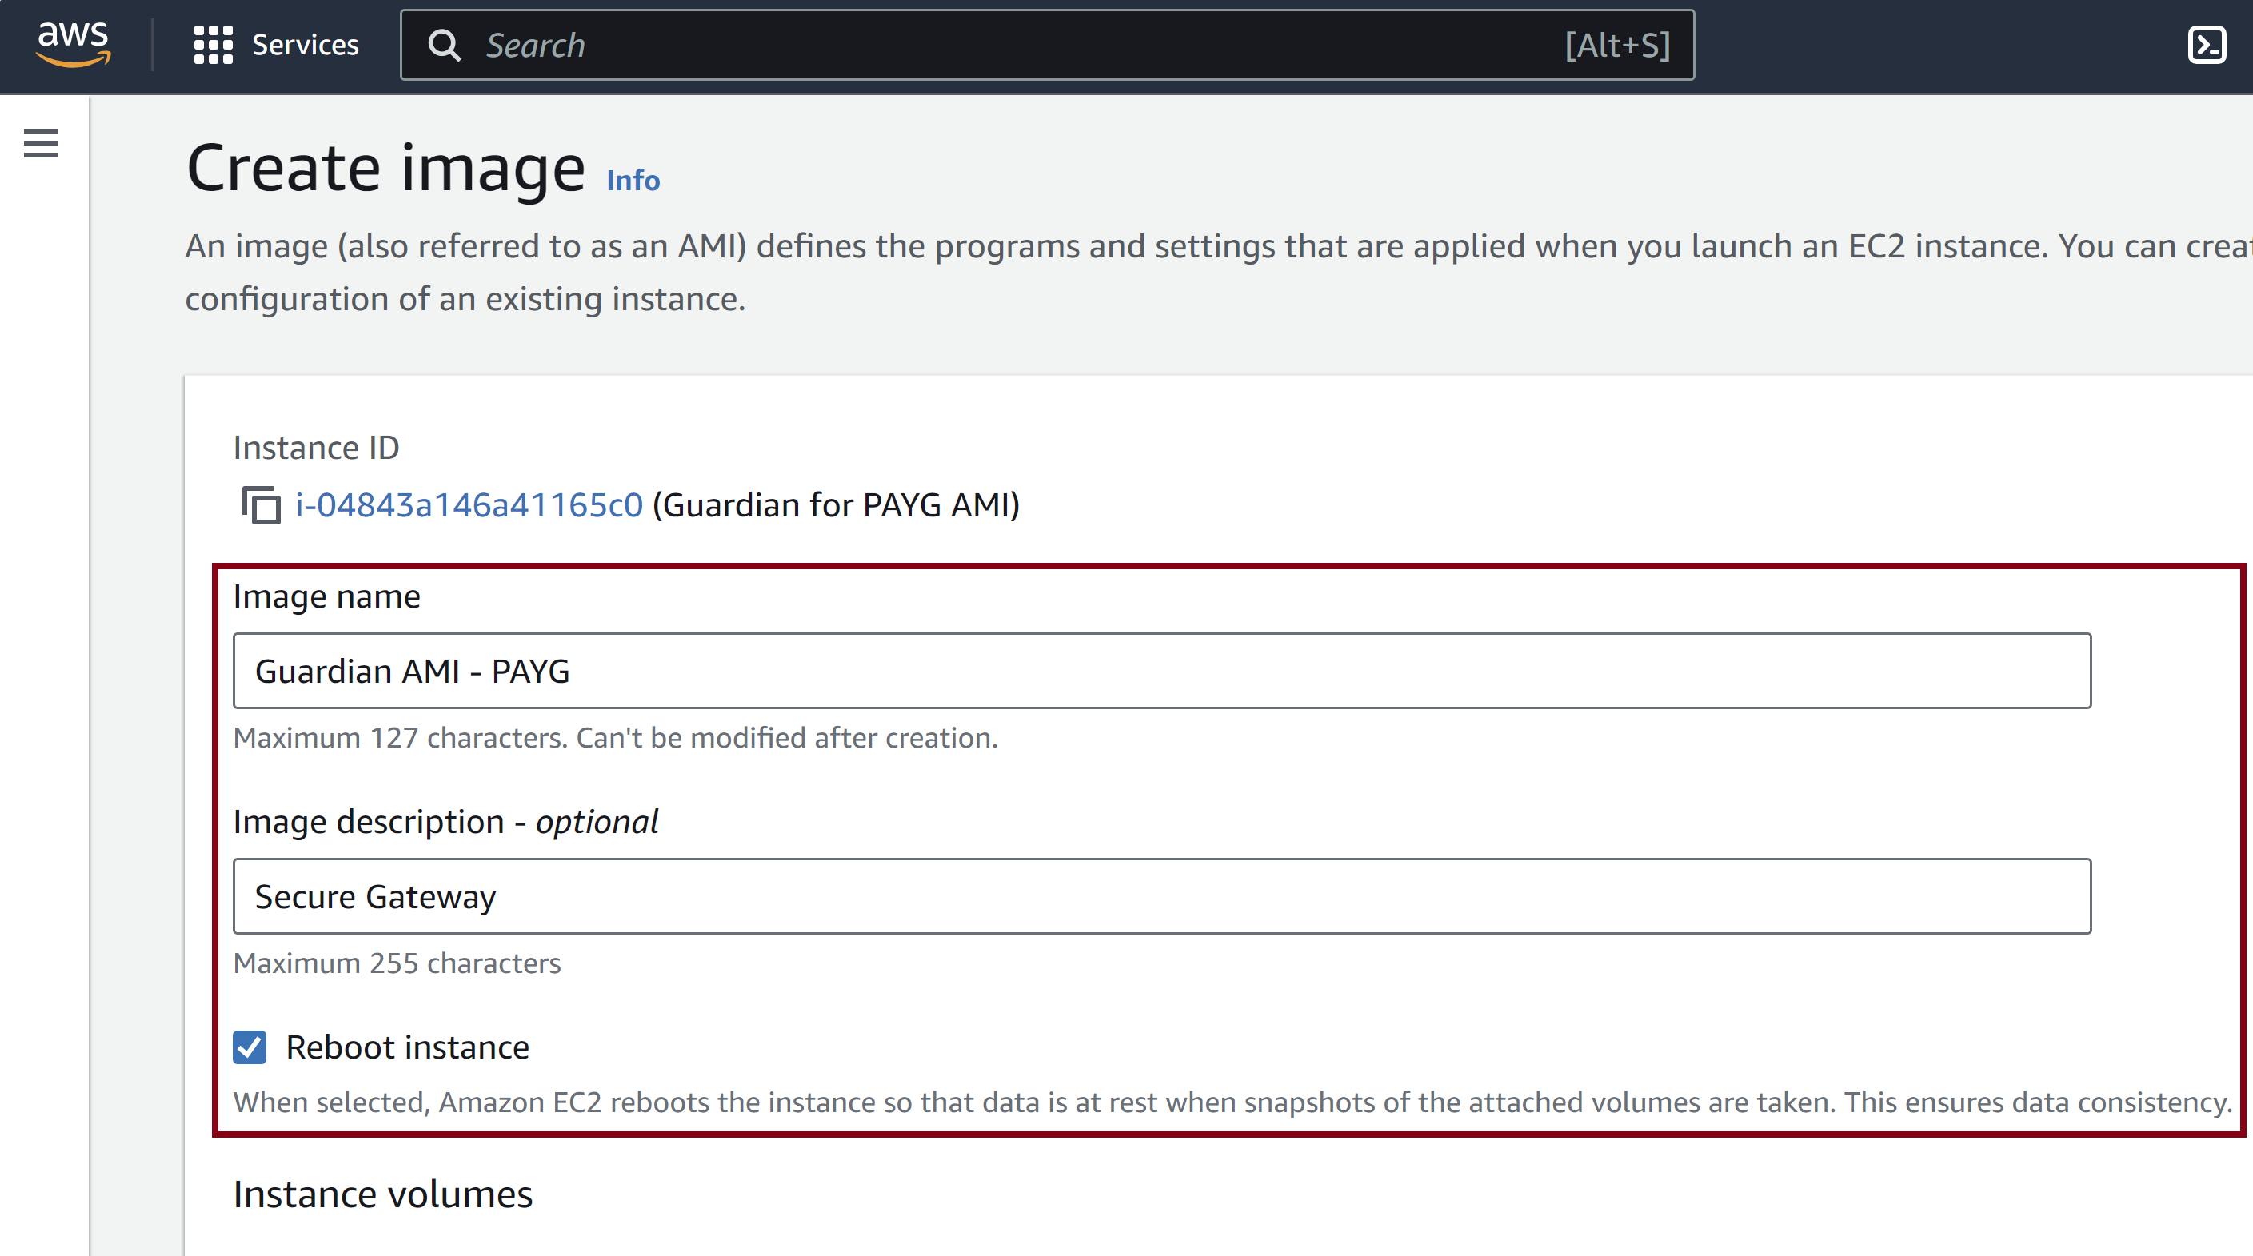
13. Enter a Name

Slide 20
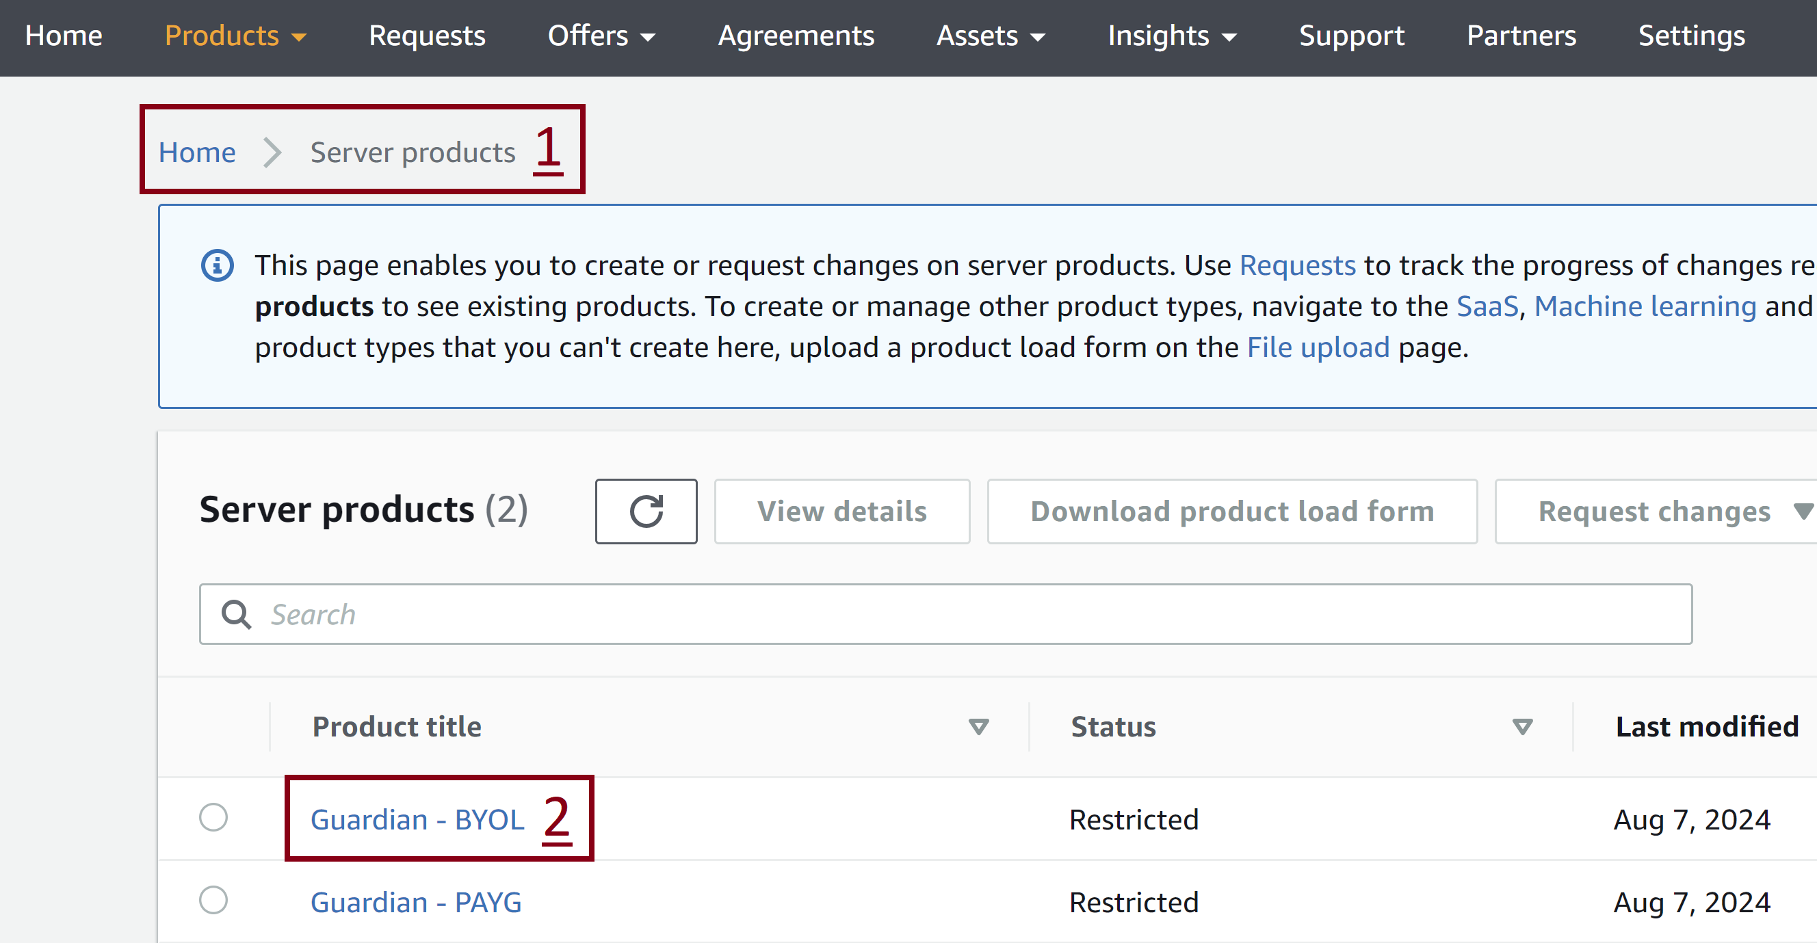
14. Open the Server Product
https://aws.amazon.com/marketplace/management/products/server?#

Slide 21
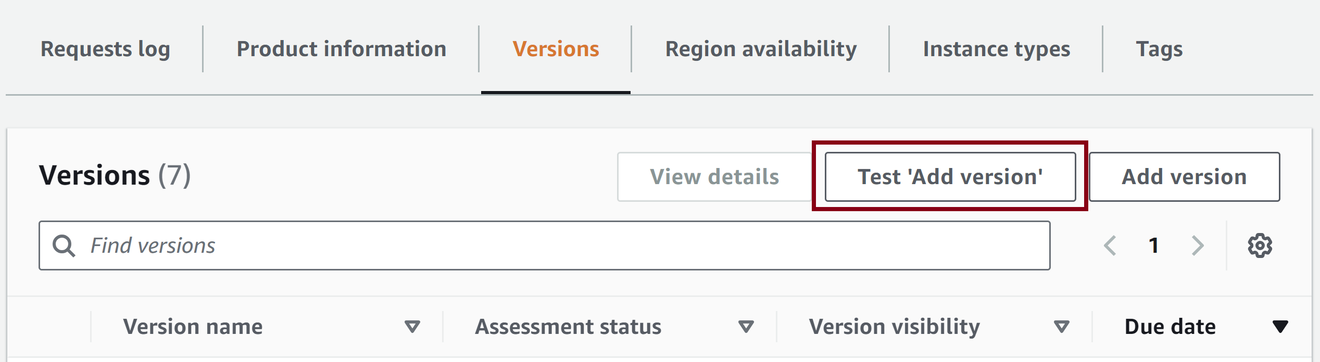
15. Test 'Add version'
https://aws.amazon.com/marketplace/management/products/6fa4b983-5a18-4fd0-a28f-48f851289700/overview
arn:aws:iam::135319629286:role/AWS-Marketplace

Slide 22
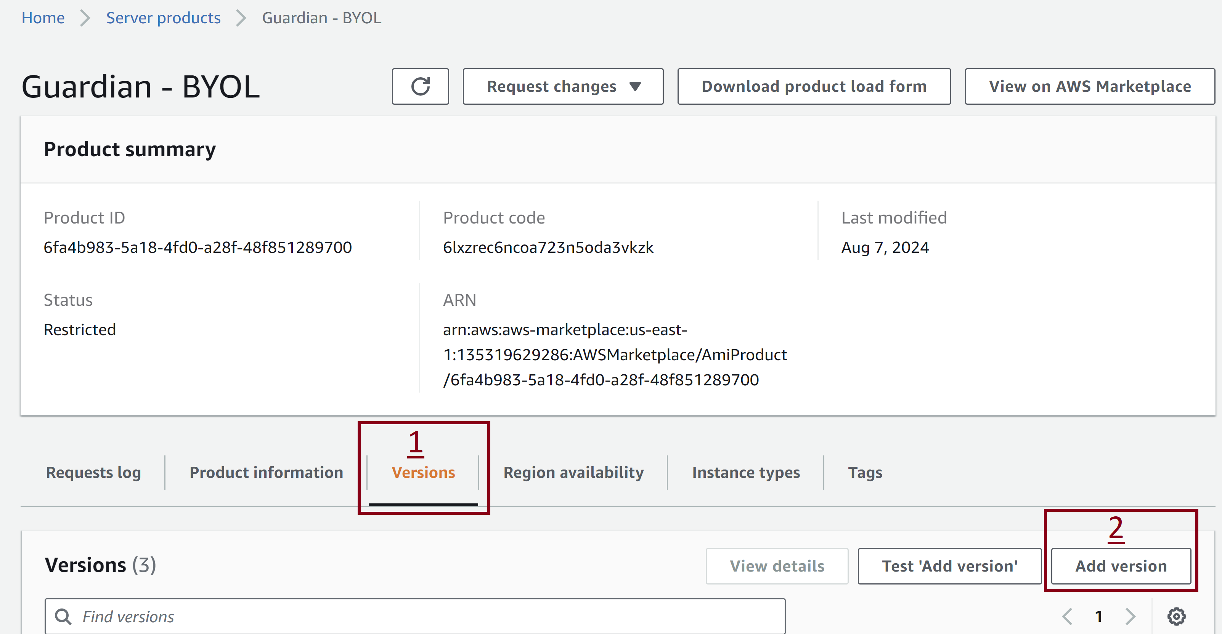
16. Add version

Slide 23
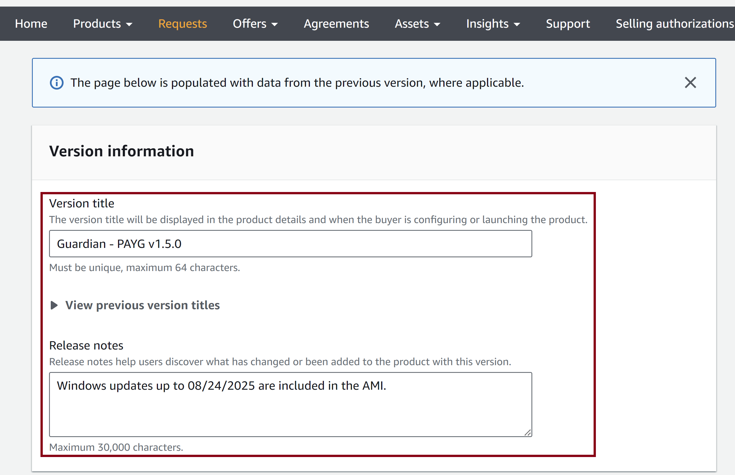
17. Enter Title and Notes

Slide 24
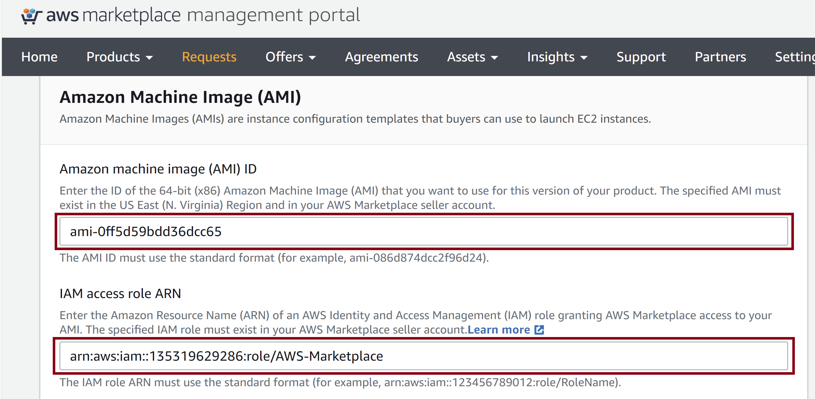
18. Enter AMI ID and ARN
arn:aws:iam::135319629286:role/AWS-Marketplace

Slide 25
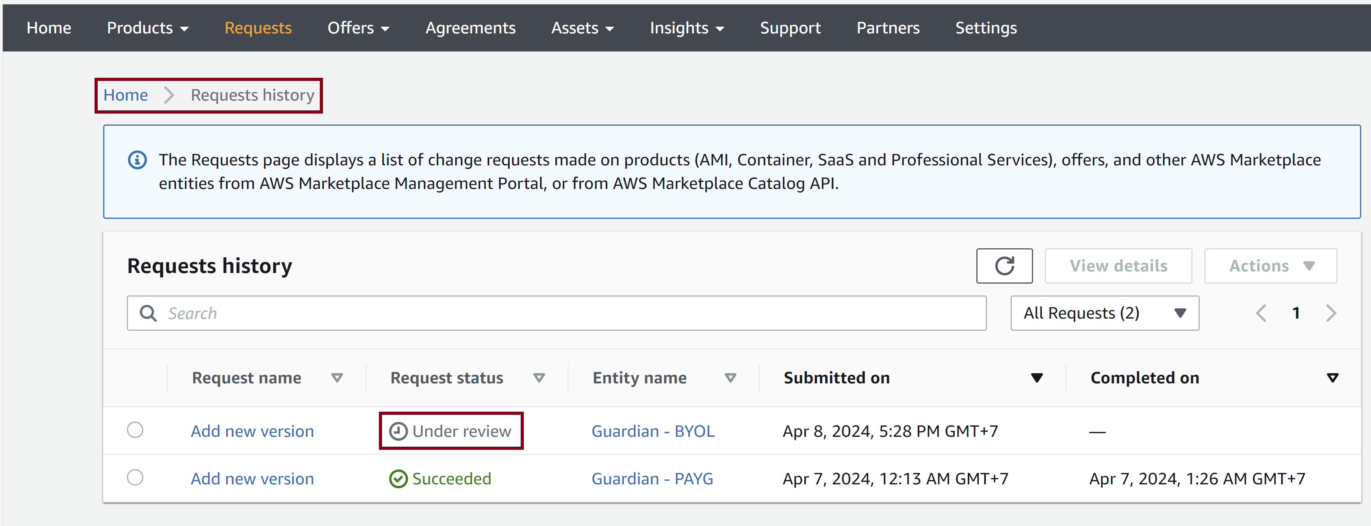
19. Review the Update Status
https://aws.amazon.com/marketplace/management/requests

Slide 26
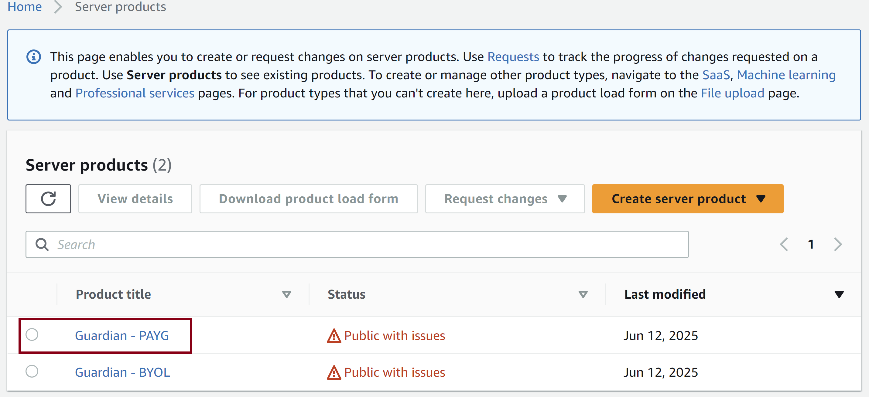
20. Open the Exiting Product
https://aws.amazon.com/marketplace/management/products/server

Slide 27
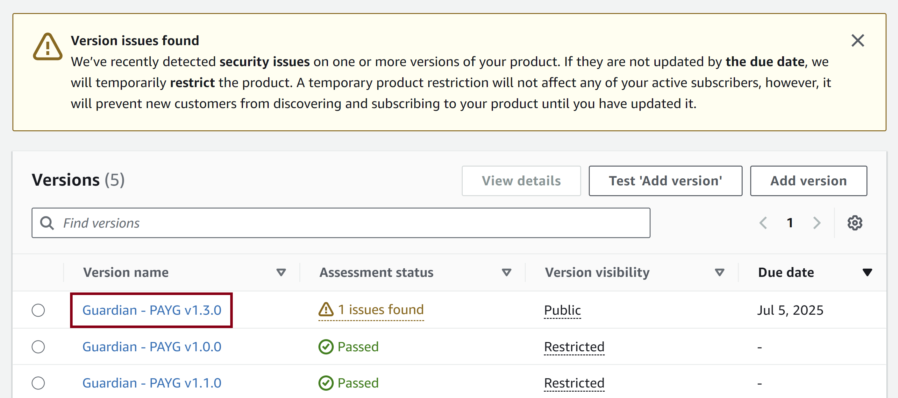
21. Select the Version with Issues

Slide 28
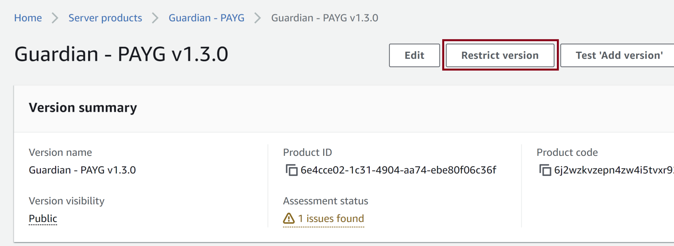
22. Restrict the Version

Slide 29
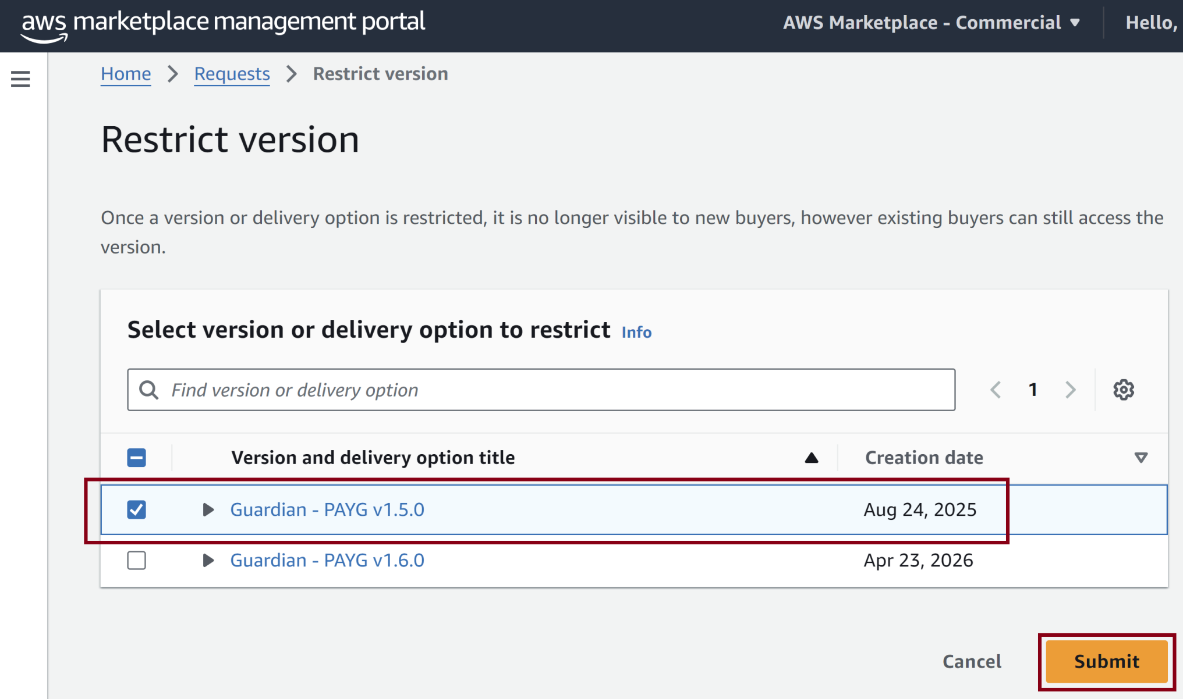
23. Select the Version to Restrict

Slide 30


Slide 31
What is AWS Marketplace?
https://docs.aws.amazon.com/marketplace/latest/userguide/what-is-marketplace.html
AWS Marketplace is a curated digital catalog that customers can use to find, buy, deploy, and manage third-party software, data, and services to build solutions and run their businesses.
AWS Marketplace includes thousands of software listings from popular categories such as security, business applications, machine learning, and data products across specific industries, such as healthcare, financial services, and telecommunications.
Customers can quickly launch preconfigured software, and choose software solutions in Amazon Machine Images (AMIs), software as a service (SaaS), and other formats.

Slide 32
Buyers, Sellers and Partners
You can use AWS Marketplace as a buyer (subscriber), seller (provider), or both.
Anyone with an AWS account can use AWS Marketplace as a buyer, and can register to become a seller.
A seller can be an independent software vendor (ISV), channel partner, managed services provider (MSP), or individual who has something to offer that works with AWS products and services.
Eligible partners can programmatically list AWS Marketplace products outside of AWS Marketplace. For more information about becoming an eligible partner, contact your AWS Marketplace business development partner.

Slide 33
1. Review Seller Process
https://docs.aws.amazon.com/marketplace/latest/userguide/seller-registration-process.html
By registering as a seller for AWS Marketplace, you can sell your products and services to other AWS Marketplace customers.

Slide 34
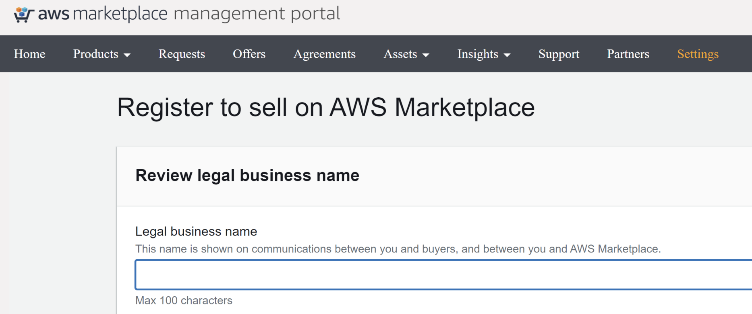
2. Register Seller Account
https://aws.amazon.com/marketplace/management/seller-settings/register

Slide 35
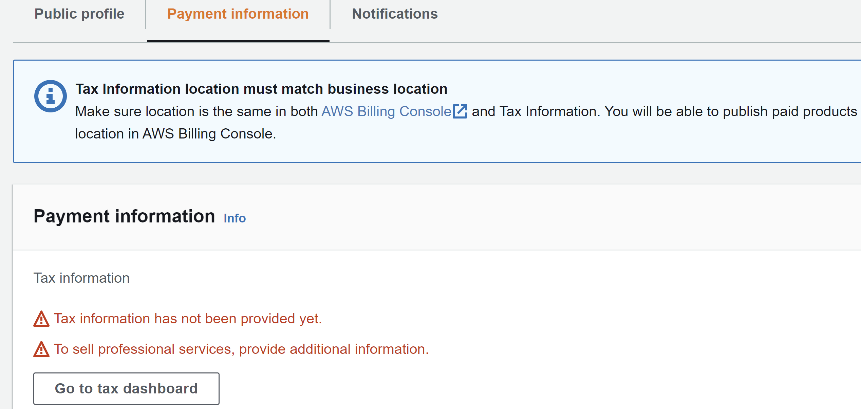
3. Provide Tax information
https://aws.amazon.com/marketplace/management/seller-settings/account

Slide 36
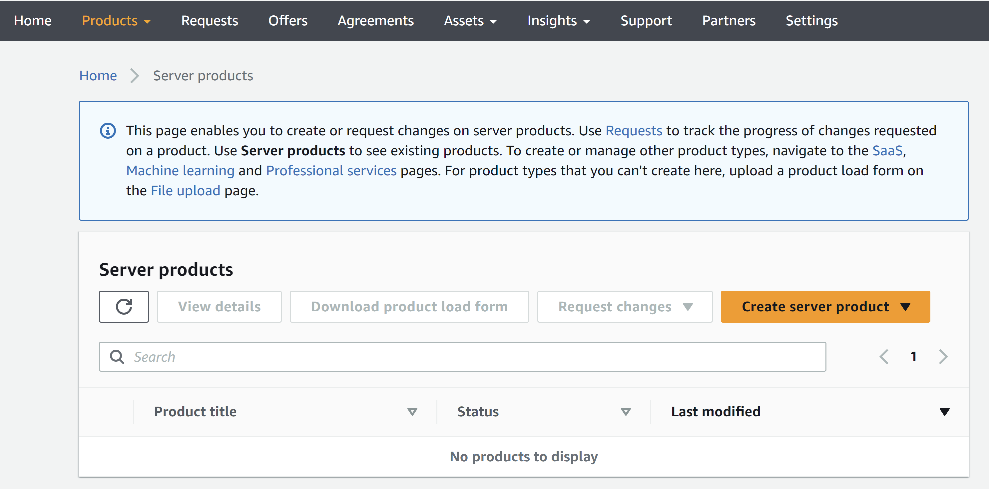
4. Go to Server Products (AMIs)
https://aws.amazon.com/marketplace/management/products/server

Slide 37
5. Prepare Your Product
https://docs.aws.amazon.com/marketplace/latest/userguide/product-preparation.html
Preparing to publish a product on AWS Marketplace includes configuring your package, setting a pricing scheme, determining the relevant categories in which to list your product, and adding keywords so your product appears in relevant searches.
You deliver a single custom Amazon Machine Image (AMI) for your product. The AMI provides the information required to launch an Amazon Elastic Compute Cloud (Amazon EC2) instance.
Buyers can use the single AMI to create Amazon EC2 instances with your product already installed and ready to use.

Slide 39
Terminology: EC2Launch v2
https://docs.aws.amazon.com/AWSEC2/latest/WindowsGuide/ec2launch-v2-overview.html
EC2Launch v2 is a service that performs tasks during instance startup and runs if an instance is stopped and later started, or restarted.
https://docs.aws.amazon.com/AWSEC2/latest/WindowsGuide/ec2launch-v2-install.html
EC2Launch v2 is preinstalled by default on Windows Server 2022 AMIs and UEFI AMIs.

Slide 40
Sysprep (System Preparation)
https://learn.microsoft.com/en-us/windows-hardware/manufacture/desktop/sysprep--system-preparation--overview
Sysprep (System Preparation) prepares a Windows client or Windows Server installation for imaging.
Sysprep can remove PC-specific information from a Windows installation (generalizing) so it can be installed on different PCs.
https://learn.microsoft.com/en-us/windows-hardware/customize/desktop/unattend/microsoft-windows-shell-setup-useraccounts-administratorpassword
Sysprep sets a blank password for the built-in administrator account during the sysprep /generalize process. The next time the computer starts, you, or the end user, are prompted for a password.

Slide 41
Important Notes
Do NOT use Sysprep to create a backup for your instance.
Do NOT run Sysprep on a production system.

Slide 43
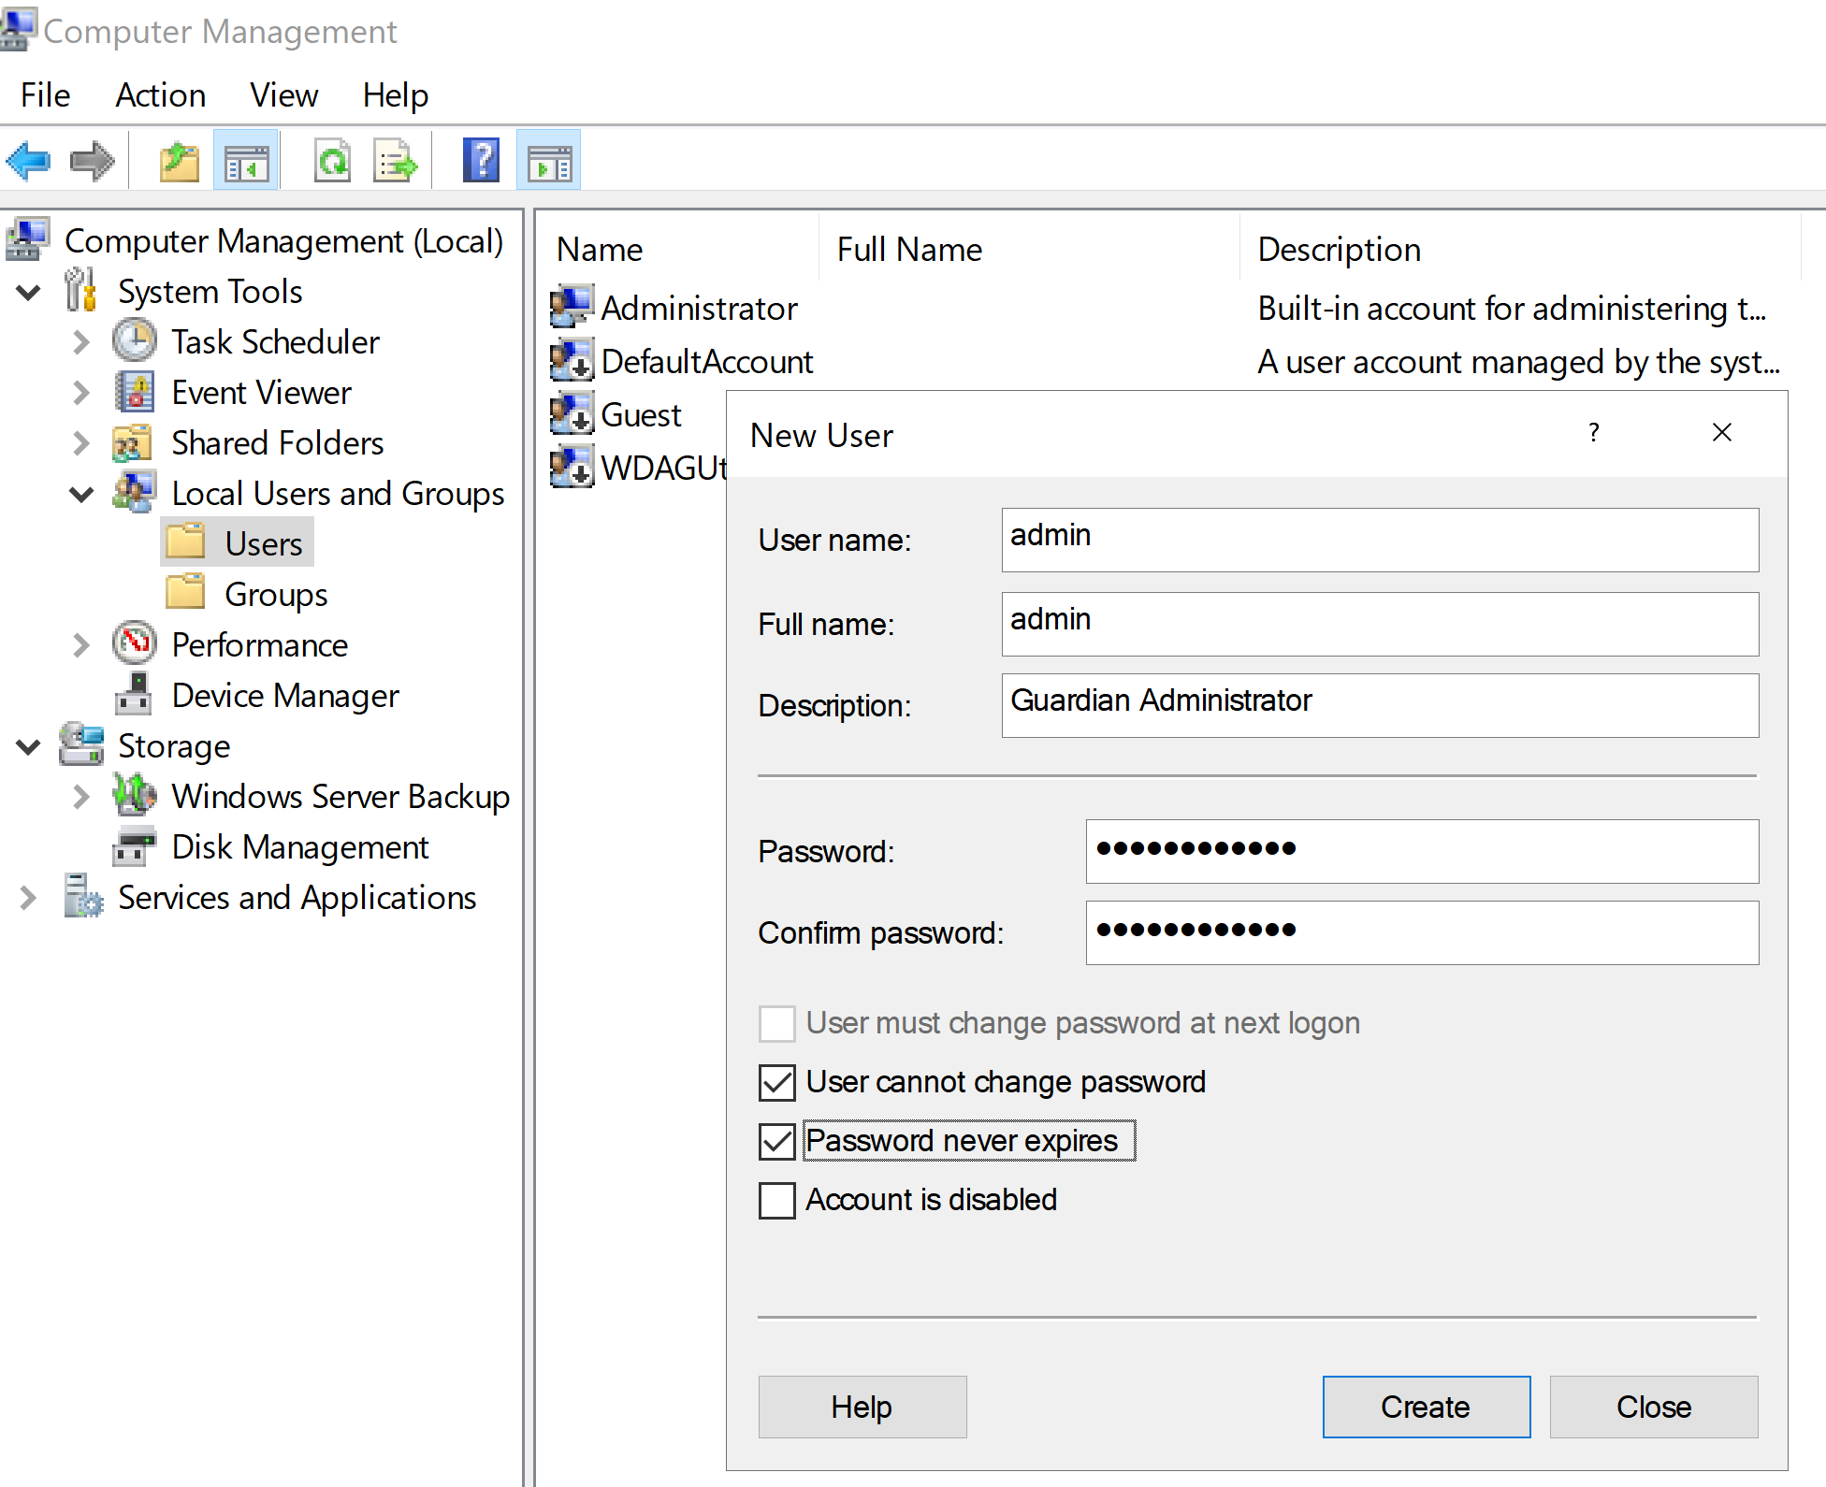
1. Create an Account
admin/ Gateway@2023

Slide 44
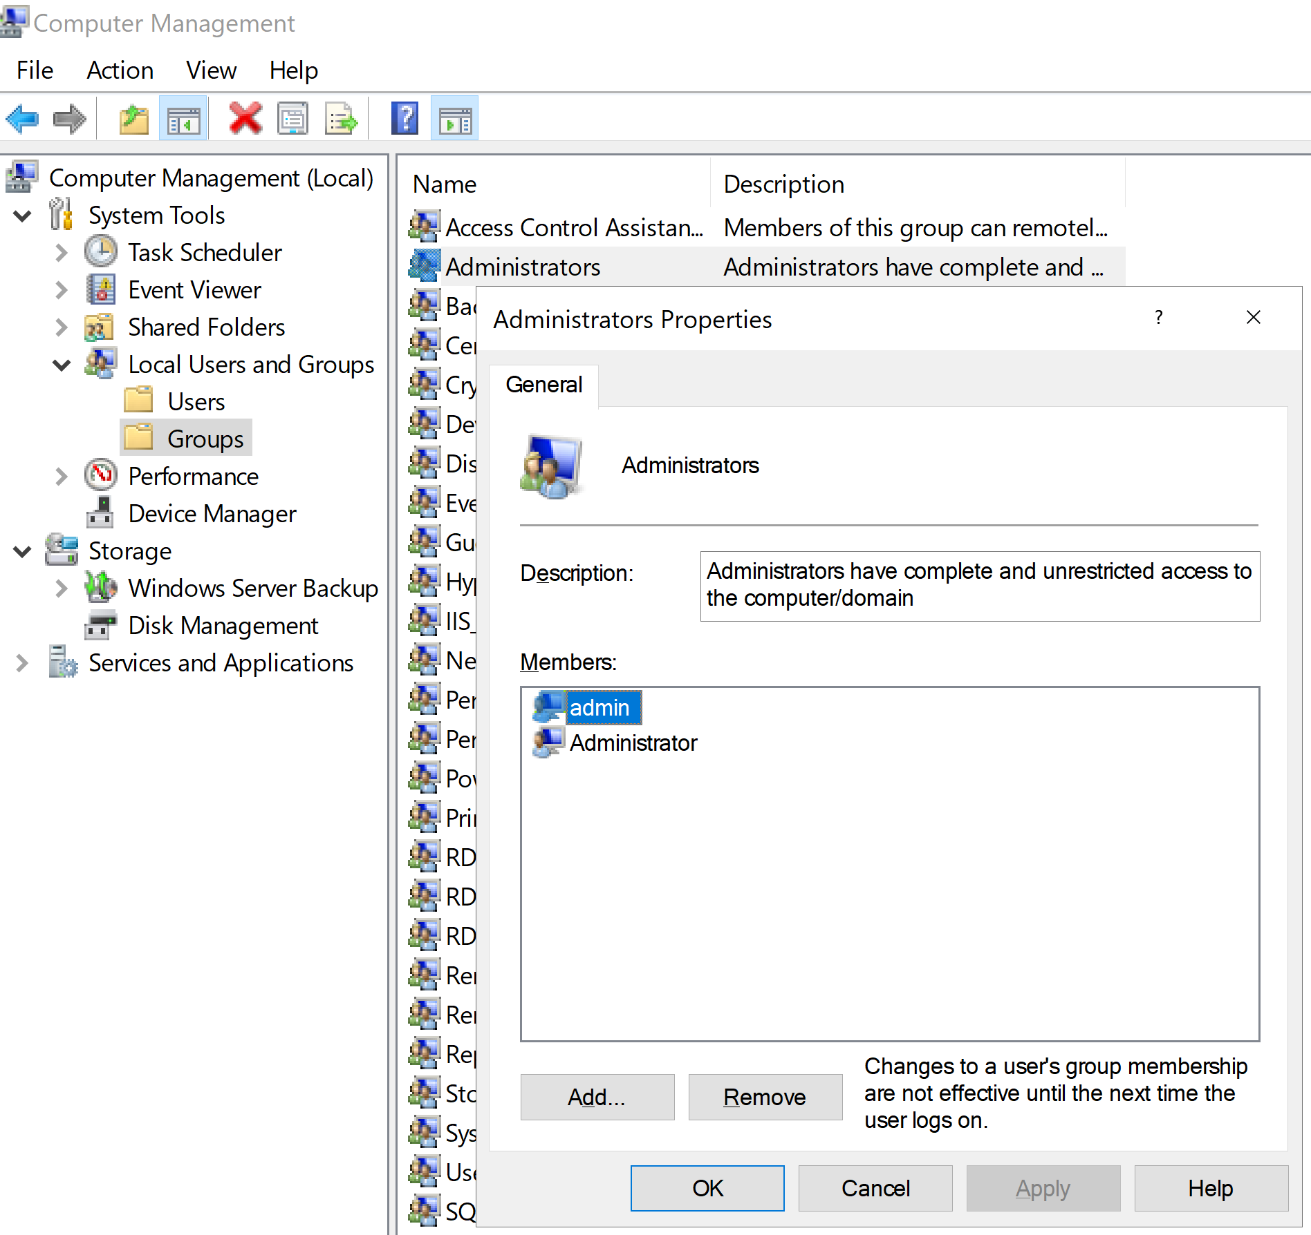
2. Add the Account to Administrators Group
Use this account for login troubleshooting if necessary.

Slide 45
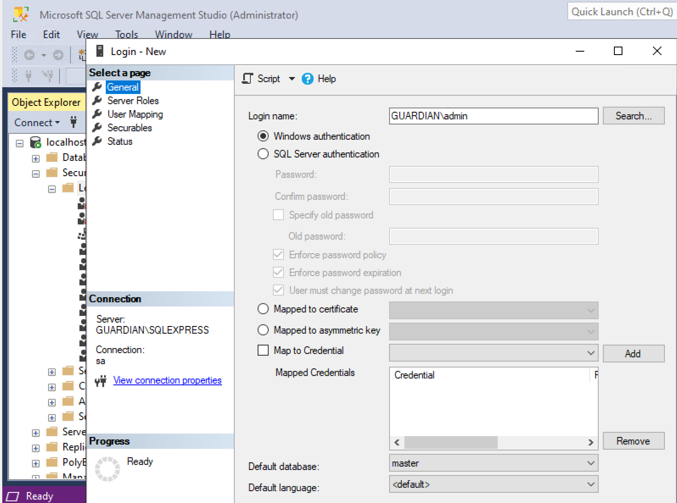
3. Add the Account to SQL Server
Select
sysadmin role
for the account.

Slide 46
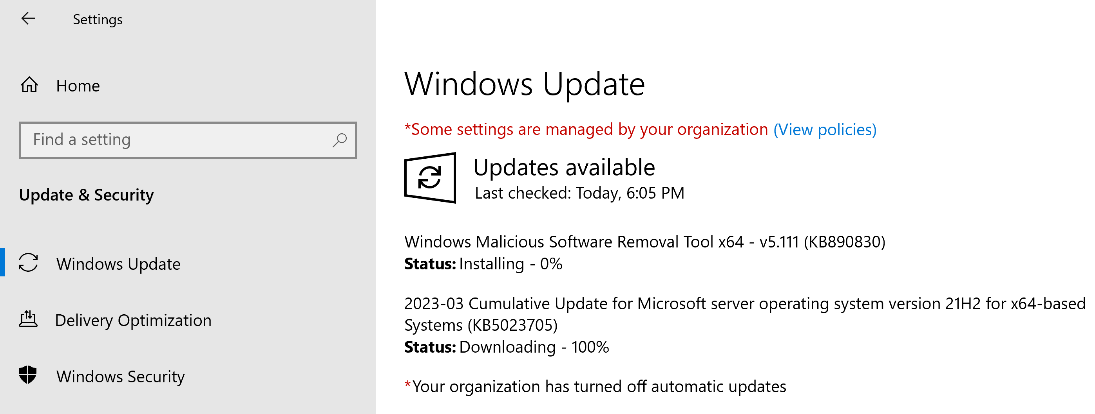
4. Install Windows Updates

Slide 47
5. Prepare VM for Creating AMI
Go to C:\Program Files\Amazon\EC2Launch\settings
Open EC2LaunchSettings.exe
Enter custom name.
Select Random (retrieve from console).
Click Save button.
Click Shutdown with Sysprep buton.
Sysprep sets a blank password for the built-in administrator account.
Use the admin account or AWS Get Windows password to access the VM after Sysprep is run.

Slide 48
6. Wait until the VM is Shut Down

Slide 50
1. Create an AMI

Slide 51
2. Enter a Name

Slide 52
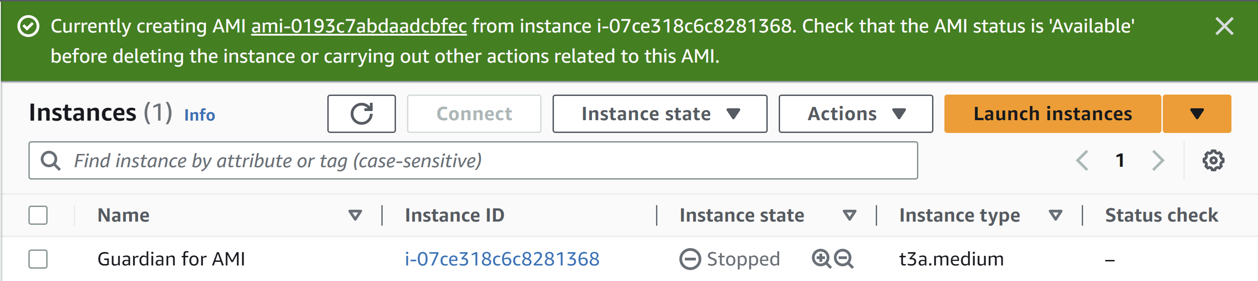
3. Go to the AMI

Slide 53
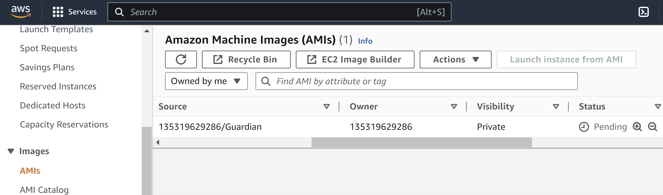
4. Review Status

Slide 54
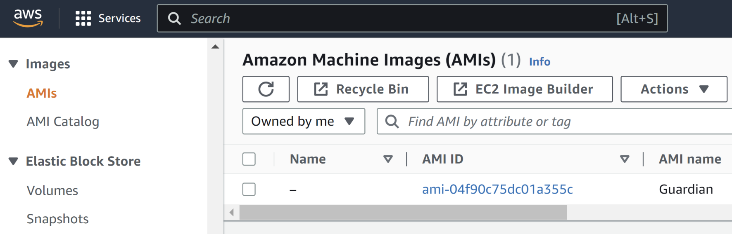
5. Retrieve AMI ID

Slide 56
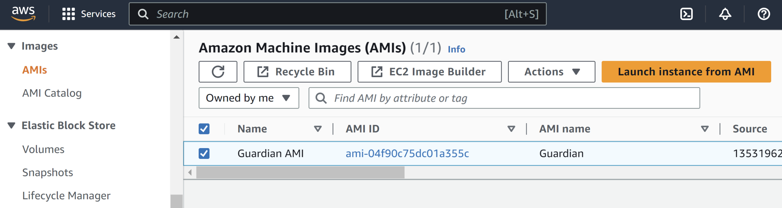
1. Launch Instance from AMI
1
2

Slide 57
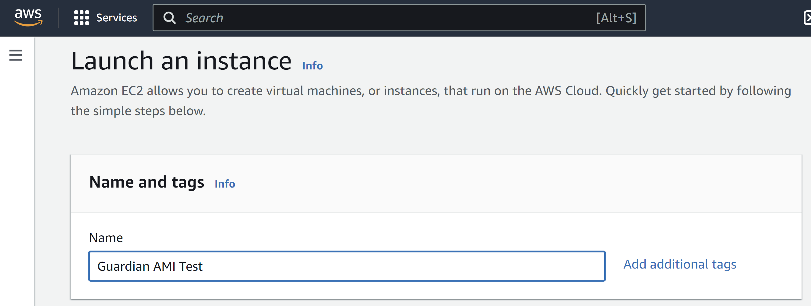
2. Enter a Name

Slide 58
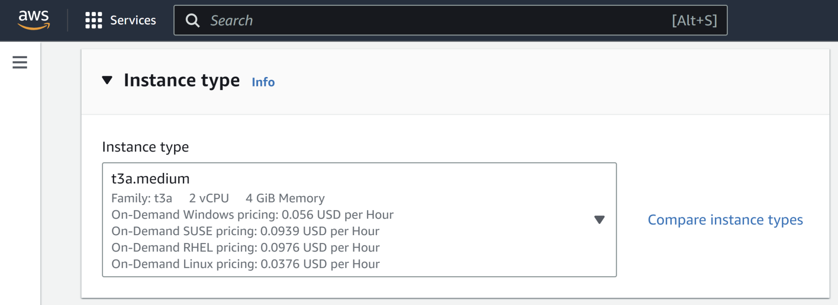
3. Select Instance Type

Slide 59
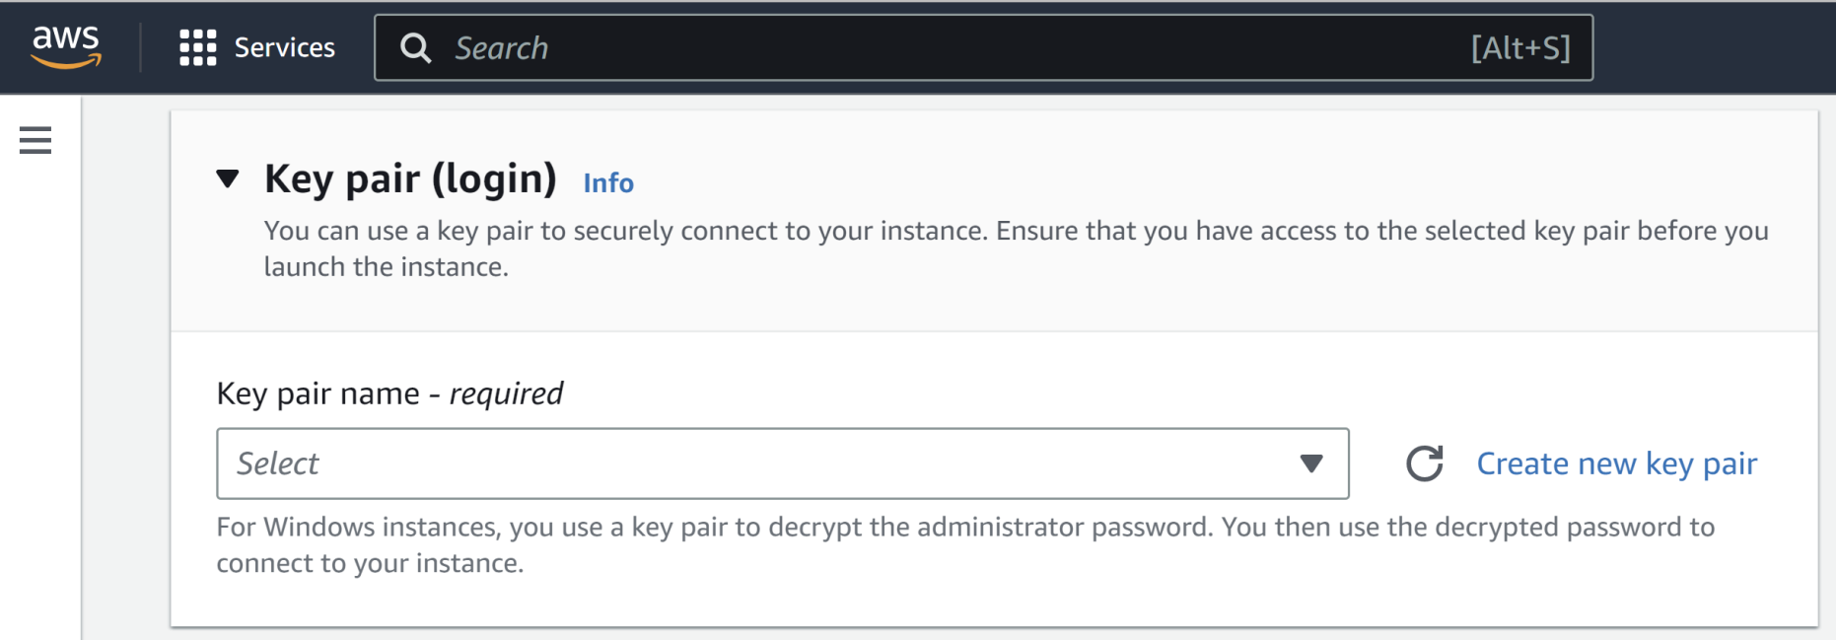
4. Create a Key Pair
Without a key pair you will not be able to decrypt Administrator's password.

Slide 60
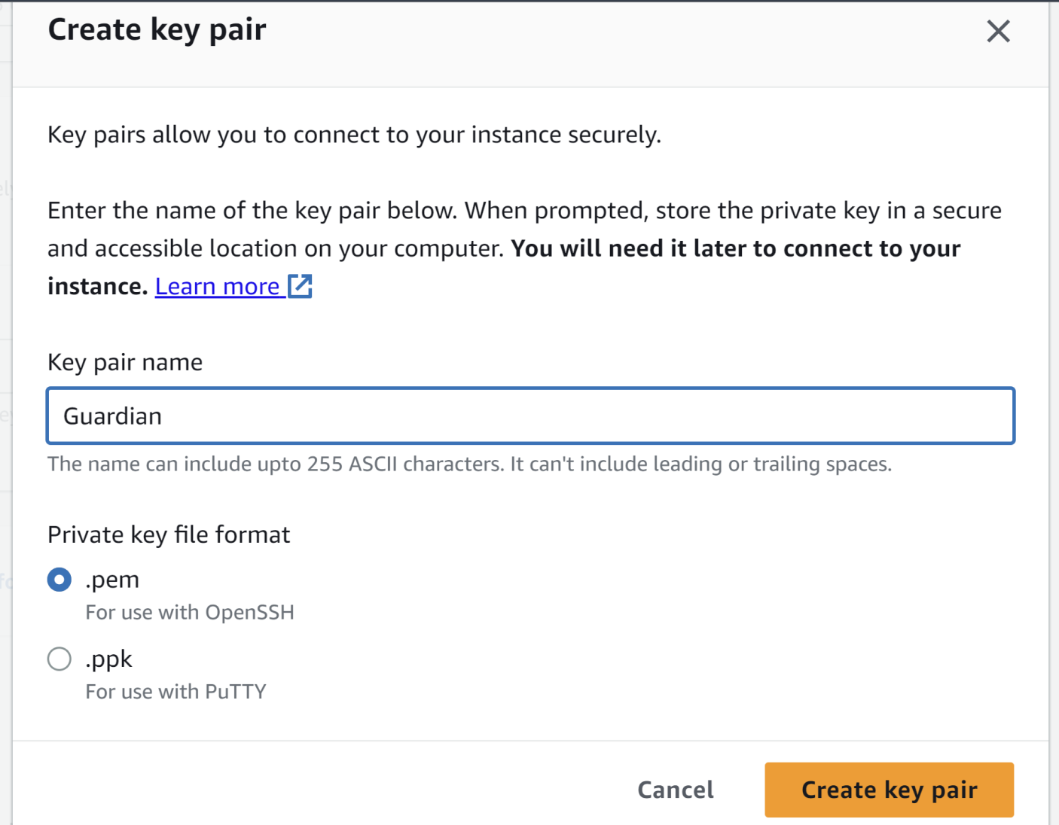
5. Enter a Name

Slide 61
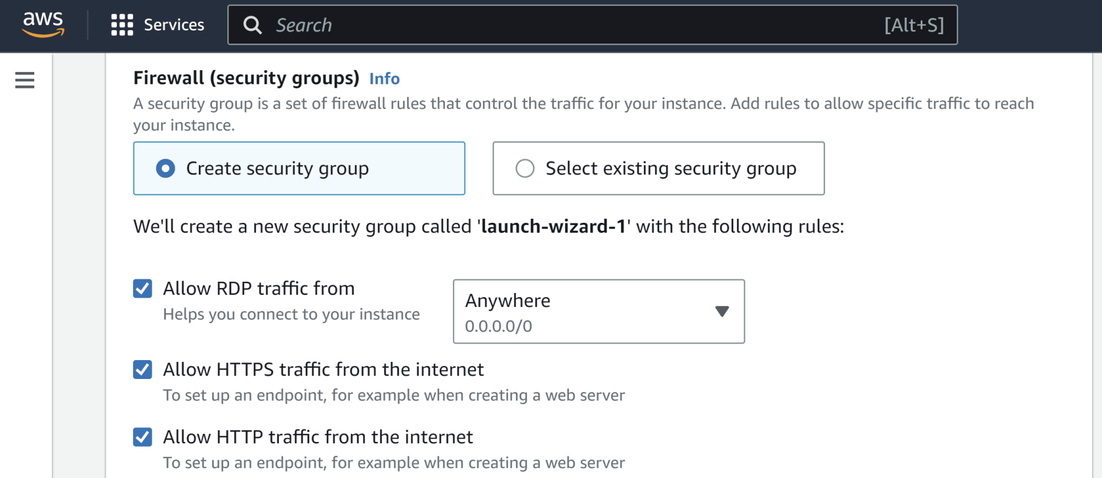
6. Create a Security Group

Slide 62
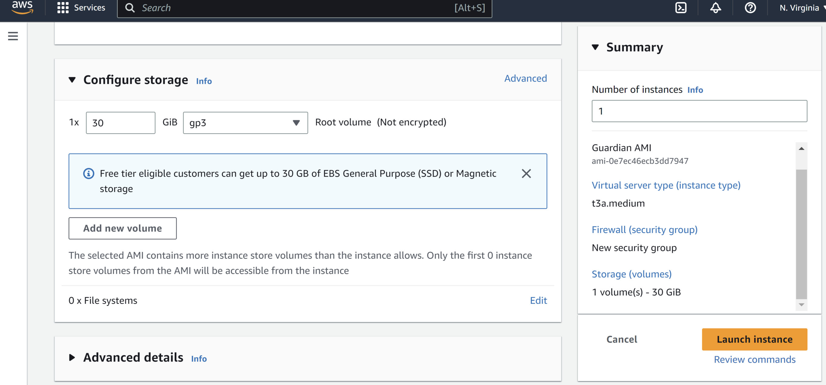
7. Confirm Instance Launch

Slide 63
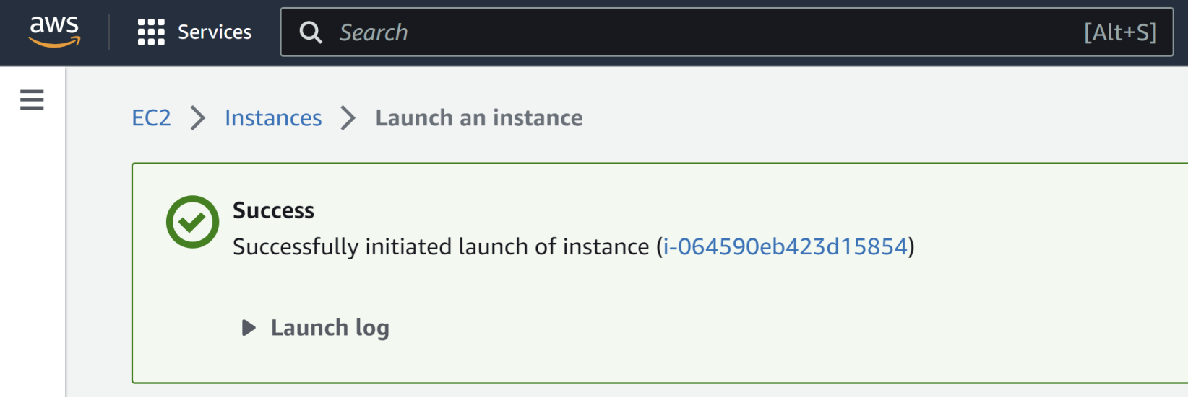
8. Go to the Instance

Slide 65
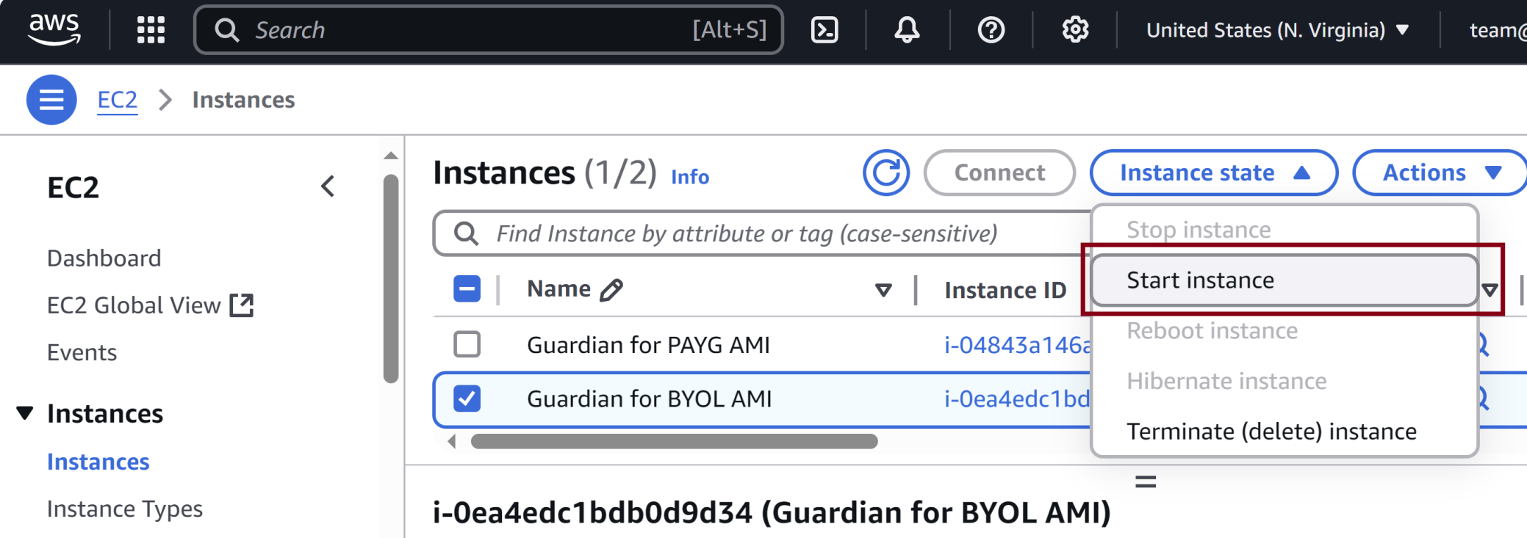
1. Start the Original Instance

Slide 66
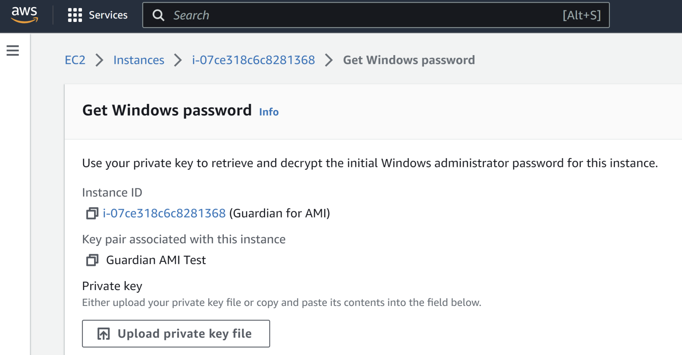
2. Go to Get Windows password
The Administrator's password was set to blank after running Sysprep.
Alternatively use the backup admin account (Password: Gateway@2023) to reset the Administrator's password.

Slide 67
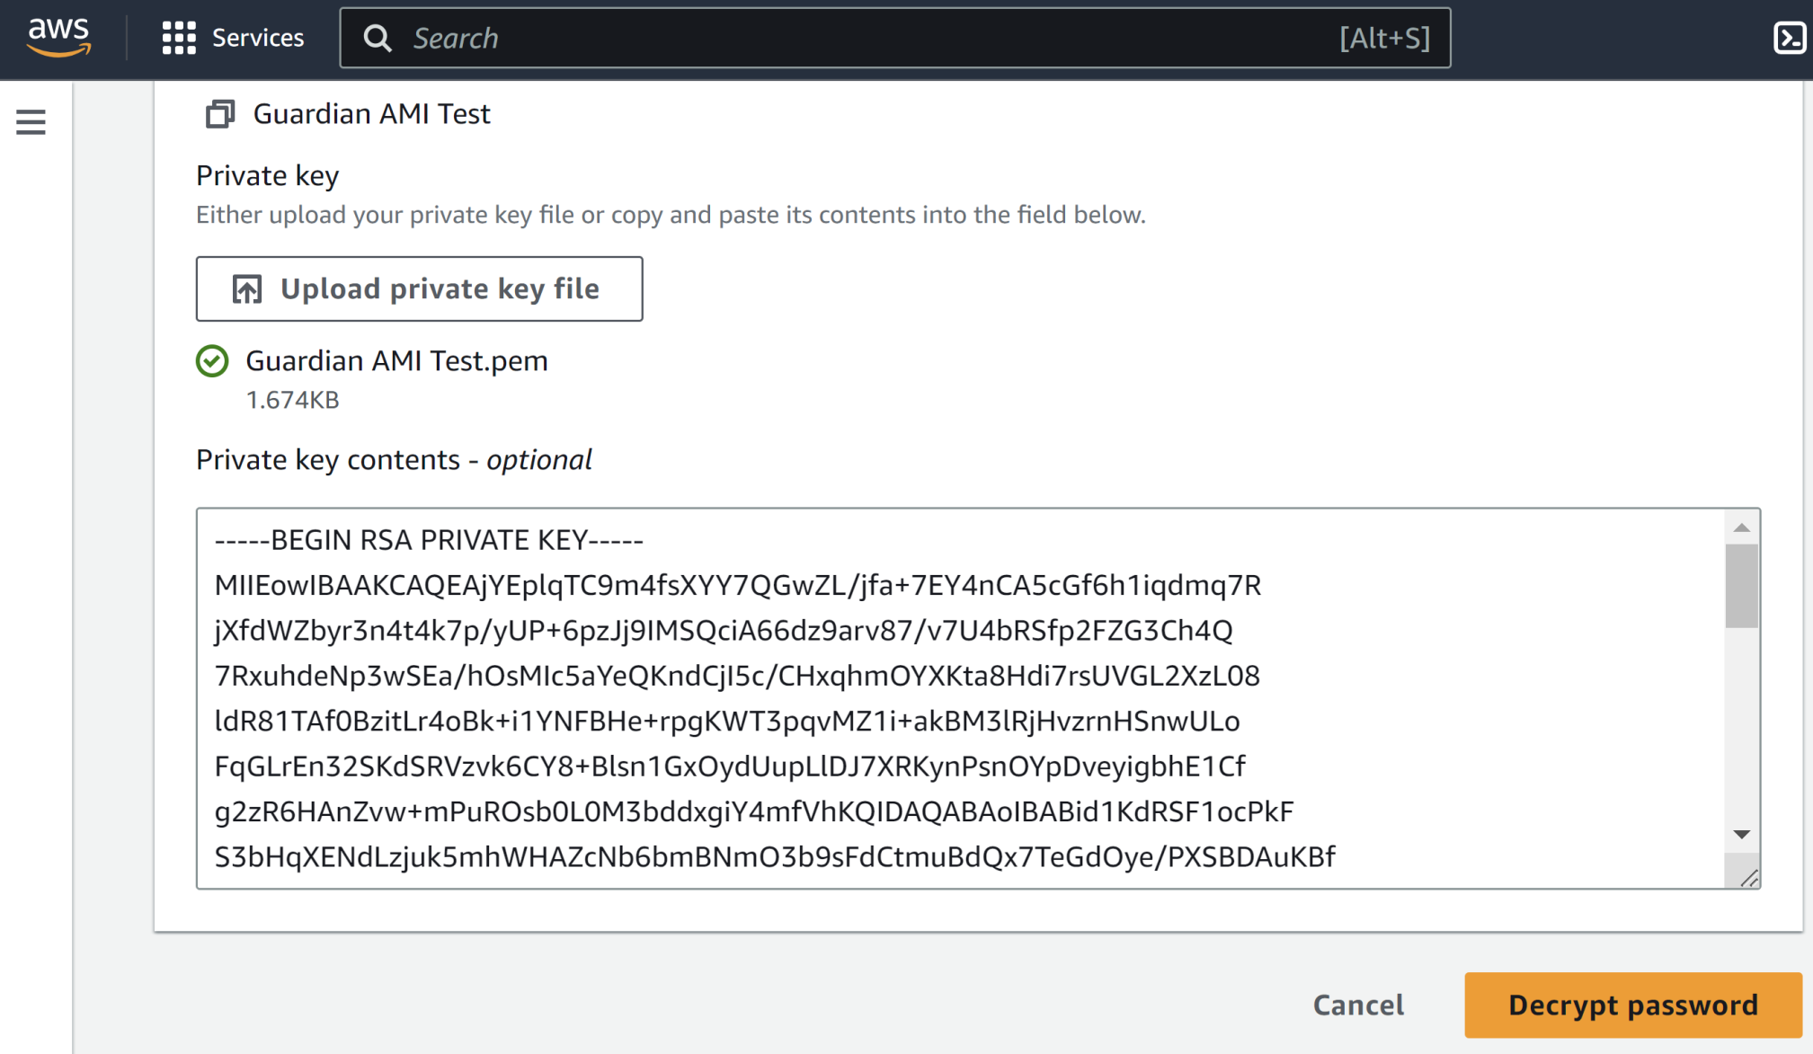
3. Get a New Password

Slide 68
4. Install Windows Updates

Slide 69
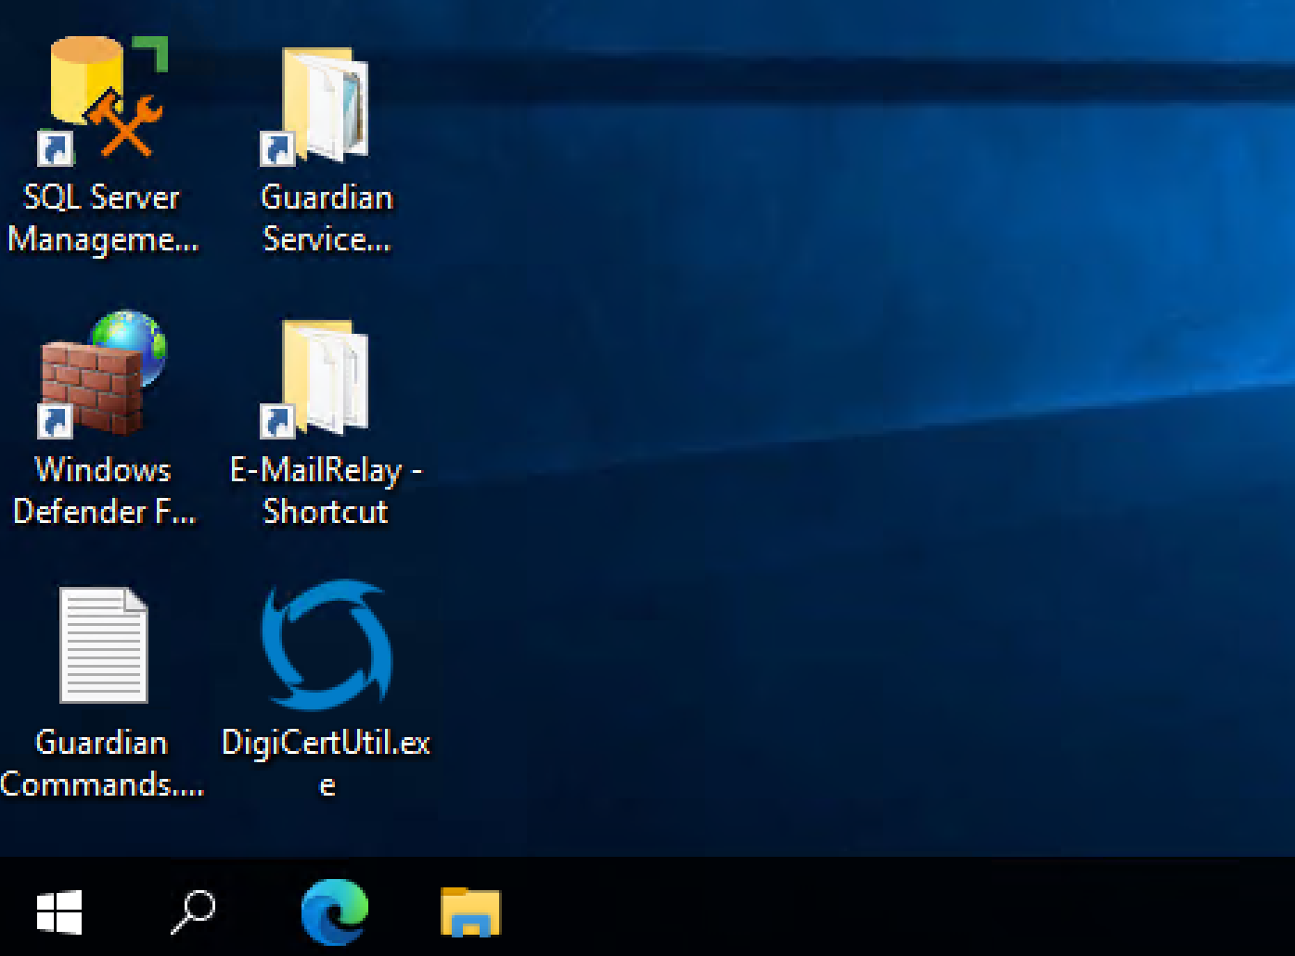
5. Open DigiCert Utility

Slide 70
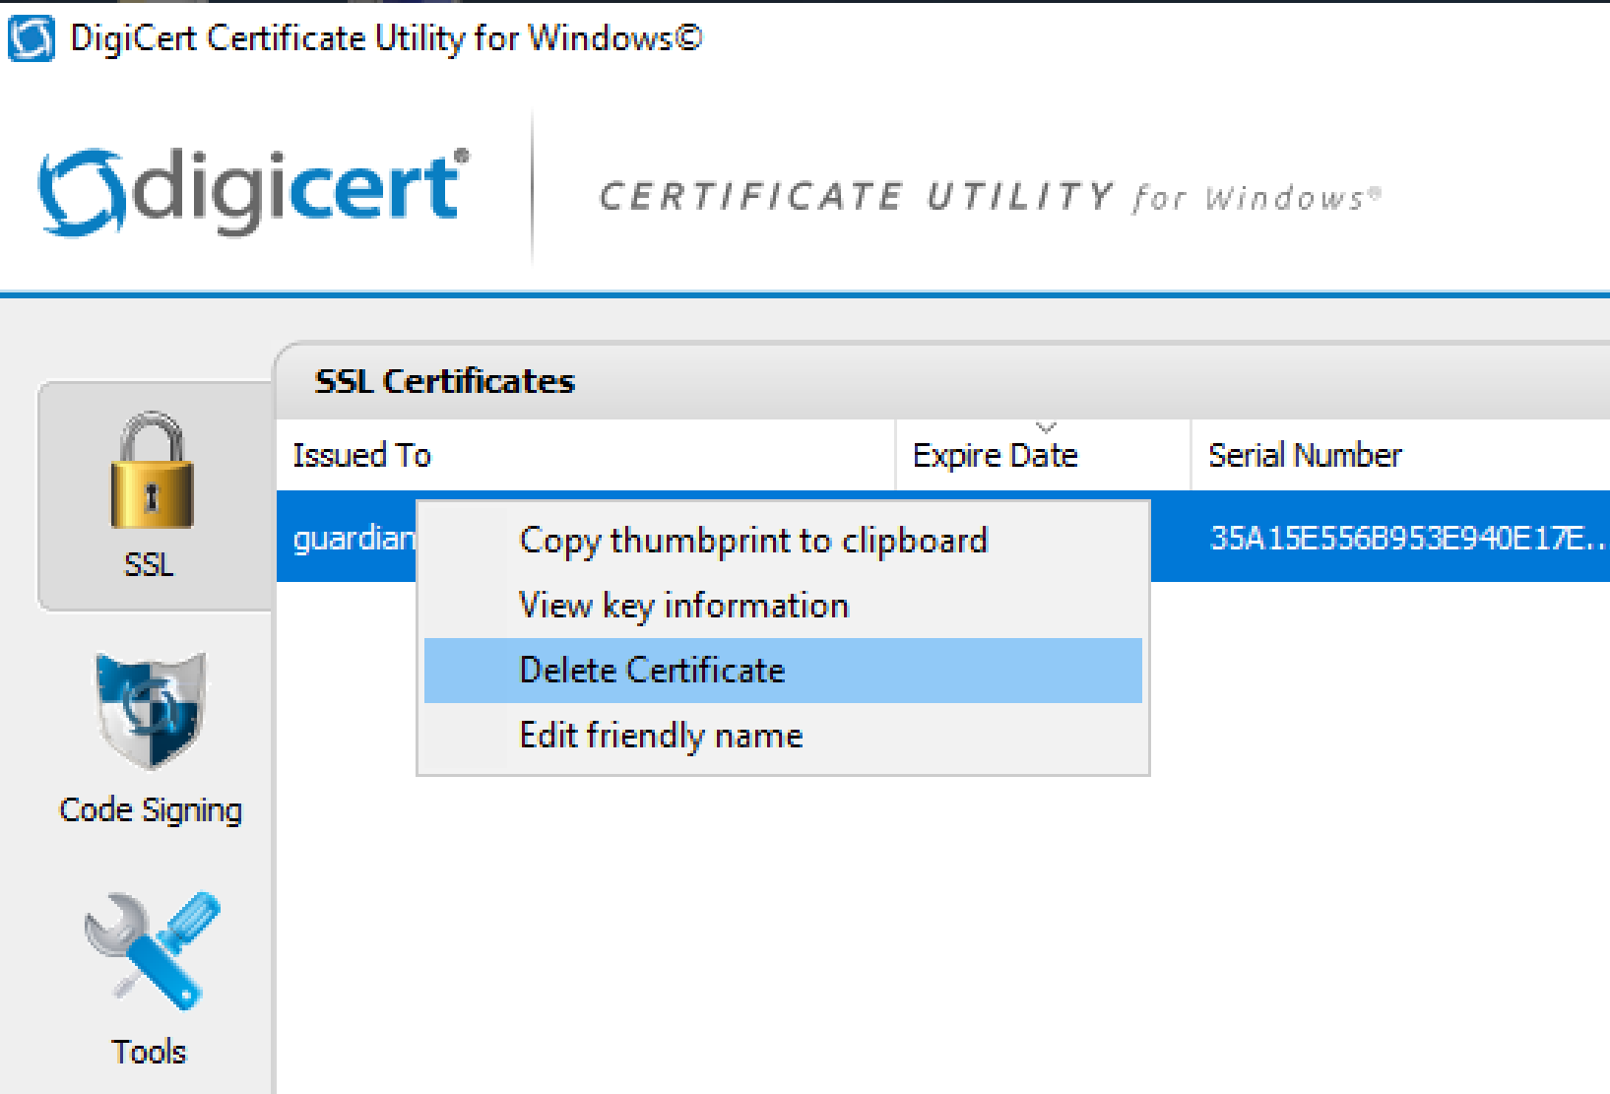
5. Delete the Existing Certificate

Slide 71
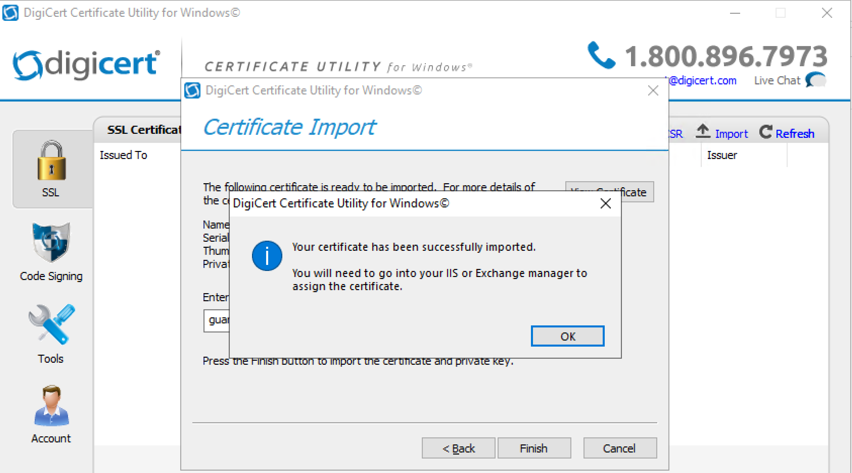
6. Import a New Certificate (PFX)

Slide 72
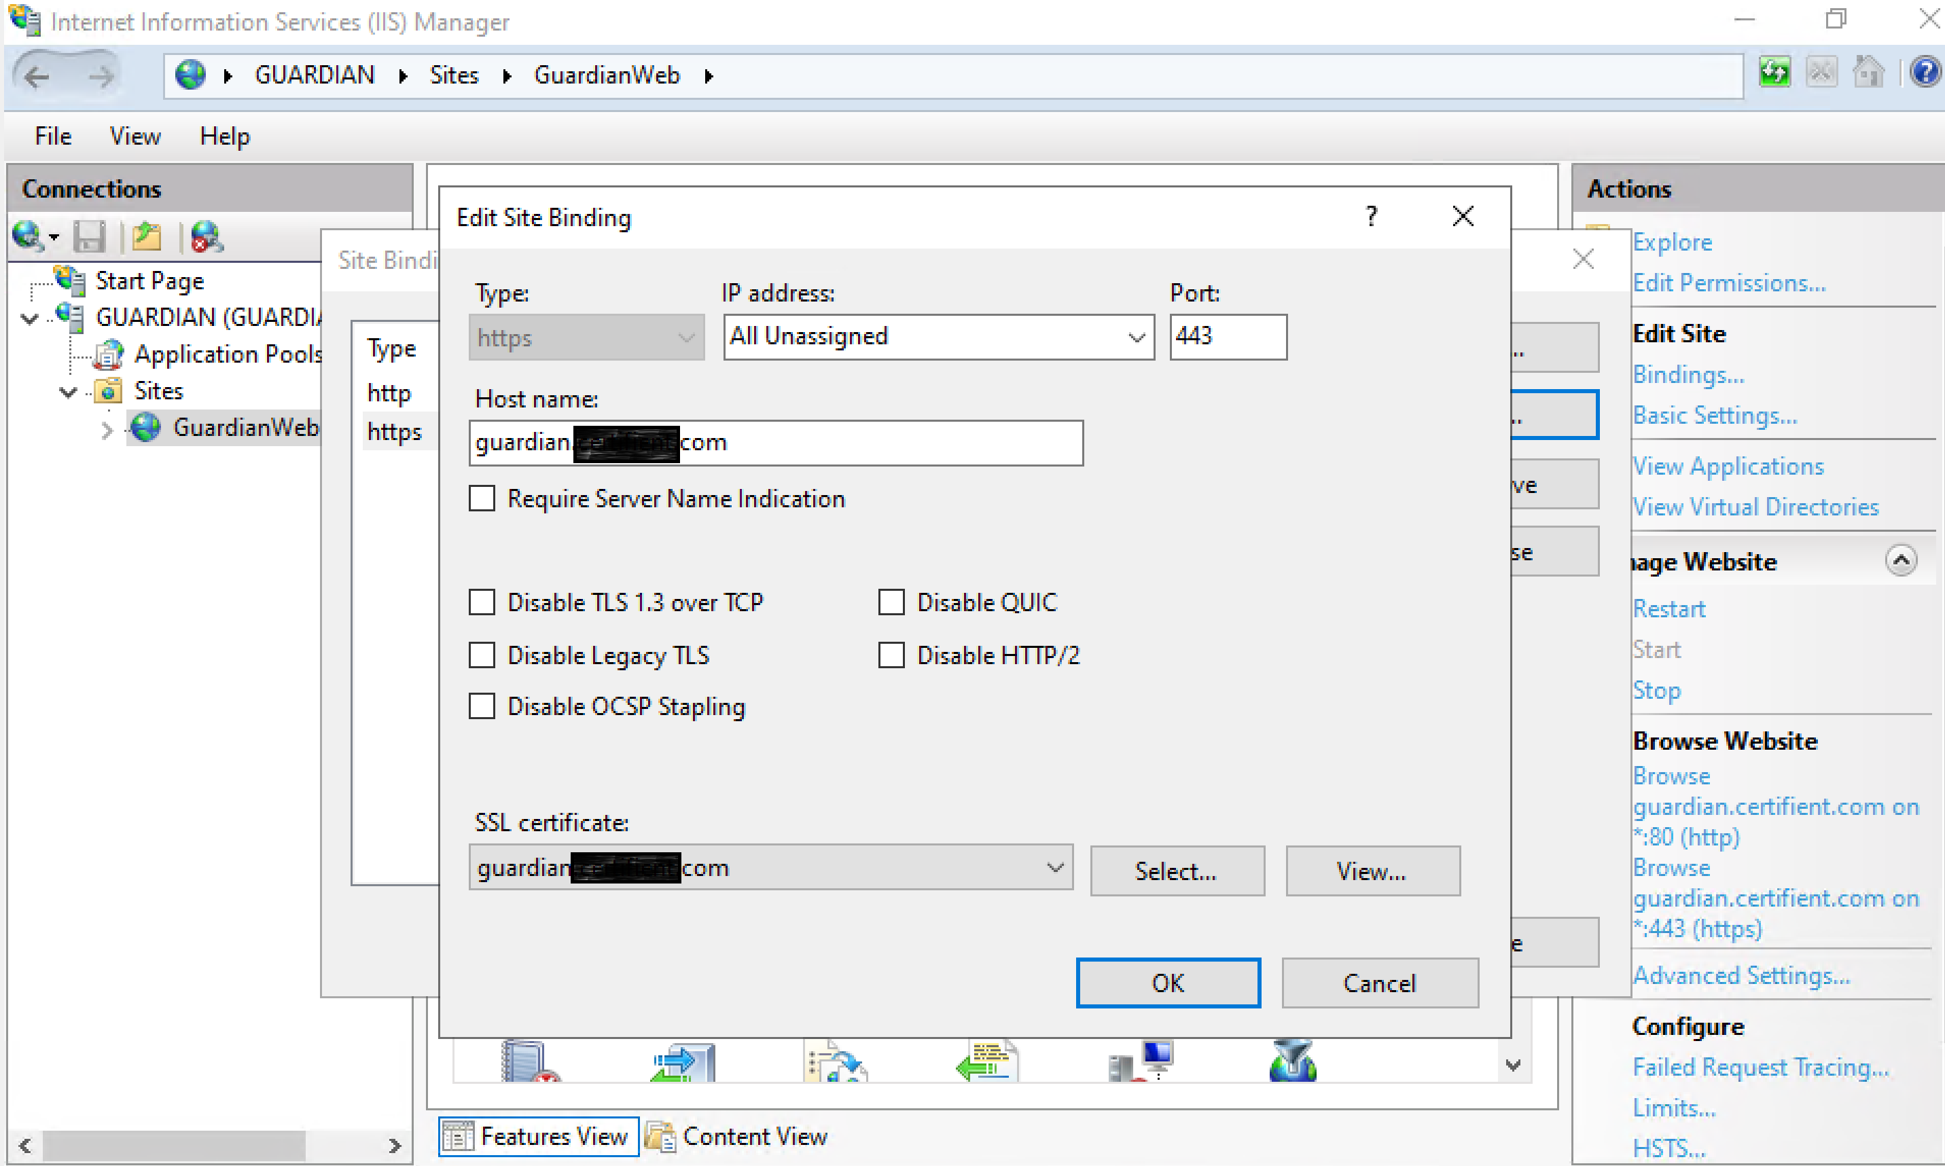
7. Rebind the SSL Certificate to the IIS Website

Slide 73
8. Open the Portal
https://guardian.ops4sight.com/

Slide 74
9. Prepare VM for Creating AMI
Go to C:\Program Files\Amazon\EC2Launch\settings
Open EC2LaunchSettings.exe
Enter custom name.
Select Random (retrieve from console).
Click Save button.
Click Shutdown with Sysprep buton.
Sysprep sets a blank password for the built-in administrator account.
Use the admin account or AWS Get Windows password to access the VM after Sysprep is run.

Slide 76
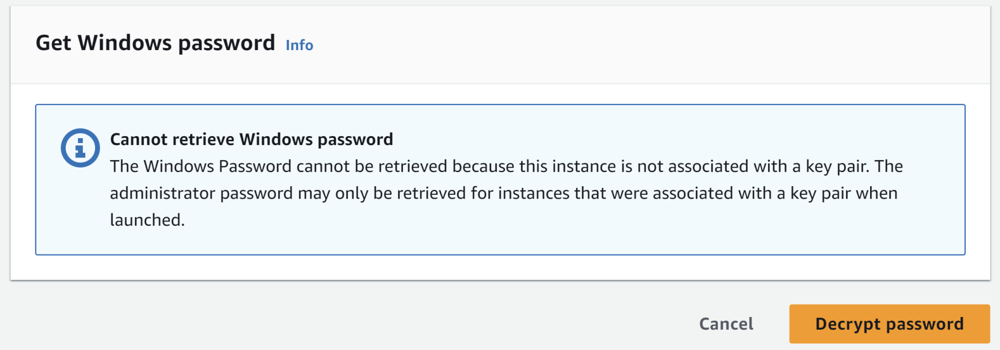
Get Windows password: No Key Pair
The Windows Password cannot be retrieved because this instance is not associated with a key pair. The administrator password may only be retrieved for instances that were associated with a key pair when launched.
Solution: Create an AMI from the instance. Launch an instance from the AMI with a new key pair.

Slide 77
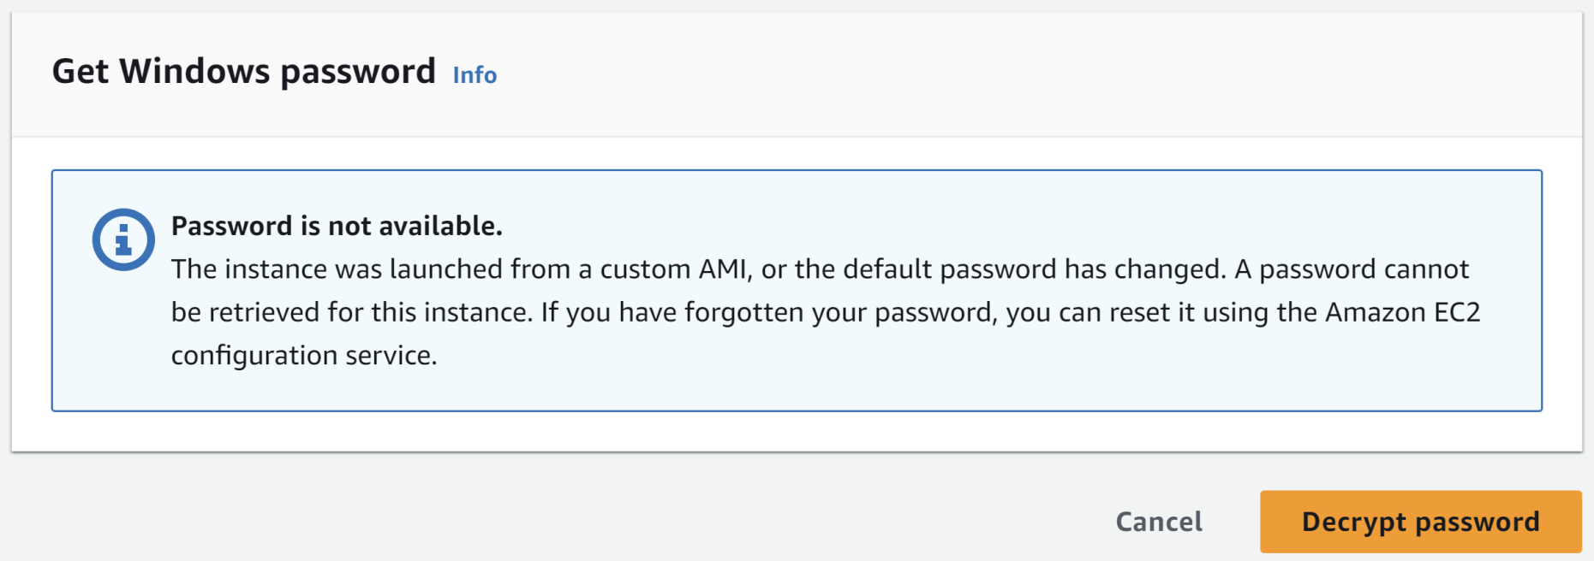
Get Windows password: Password is not available.
The instance was launched from a custom AMI, or the default password has changed. A password cannot be retrieved for this instance. If you have forgotten your password, you can reset it using the Amazon EC2 configuration service.
Solution: Attach the root volume to temporal instance. Delete the .run-once file.

Slide 78

1. Open Volume
1
2

Slide 79

2. Detach the root volume from the instance

Slide 80

3. Launch a temporary instance

Slide 81

4. Attach the detached volume

Slide 82

5. Select the temporary instance

Slide 83

6. Delete the .run-once file
D:\ProgramData\Amazon\EC2Launch\state

Slide 84

7. Attach the Volume

Slide 85

8. Enter /dev/sda1
Select an instance that is associated with a key pair.

Slide 87

1. Copy AMI to US East (N. Virginia)
Purpose: For the AMI to be able to be found by Marketplace.

Slide 88

2. Select Destination Region

Slide 89

3. Go to the Copied AMI

Slide 91

1. Create a Role
https://us-east-1.console.aws.amazon.com/iamv2/home#/roles

Slide 92

2. Select Type of Trusted Entity
Choose AWS service.

Slide 93

3. Choose a Use Case
Choose AWS Marketplace.
Choose Marketplace – AMI Assets Ingestion.

Slide 94

4. Select Policy

Slide 95

5. Enter a Name

Slide 96

6. Confirm Role Creation

Slide 97

7. Copy the ARN

Slide 99
1. Open the Server Product
https://aws.amazon.com/marketplace/management/products/server?#

Slide 100
2. Test the AMI for AWS Marketplace
https://aws.amazon.com/marketplace/management/products/6fa4b983-5a18-4fd0-a28f-48f851289700/overview
arn:aws:iam::135319629286:role/AWS-Marketplace

Slide 101

3. Review the Request Status

Slide 103

1. Remove the AMI

Slide 104

2. Delete the Unused Snapshot
1
2

Slide 106

1. Create PAYG Server Product
https://www.youtube.com/watch?v=xvYUN6HB8aQ
https://aws.amazon.com/marketplace/management/products/server

Slide 107
2. Enter General Information
SKU: Guardian - PAYG
Software by: Certifient
Title: Guardian - PAYG
Product Description: Secure Email Gateway safeguards sensitive email messages by scanning your email for compliance, and performing policy-based actions.
Short Product Description: Secure Email Gateway
Product Logo URL: https://certifient.com/wp-content/uploads/2017/04/Logo.png
Highlight 1: Rules management, messages reporting, message audit, secure email delivery.

Slide 108

3. Select Product Categories

Slide 109

4. Enter Resource URL
Search Keywords: Rules management, messages reporting, message audit, secure email delivery, secure email gateway.
Resource Name 1: Technical Specifications
Resource URL 1: https://certifient.com/technical-specifications/
Refund Policy: https://certifient.com/contact/

Slide 110
5. Enter Version Information
Version Title: Guardian - PAYG v1.0.0
Release Notes: Initial version
Usage Instructions: Please refer to https://certifient.com/wp-content/uploads/2023/04/Guardian-Usage-Instructions-PAYG.pdf

Slide 111

6. Enter AMI Information
OS Version: Windows Server 2022
OS UserName: Administrator
3rd Party Software: Certifient Guardian, E-MailRelay, SQL Server 2022 Express.
Security Group 1: tcp,3389,3389,0.0.0.0/0
Security Group 2: tcp,587,587,0.0.0.0/0
Security Group 3: tcp,80,80,0.0.0.0/0
Security Group 4: tcp,443,443,0.0.0.0/0

Slide 112

7. Select Regions

Slide 113

8. Enter Pricing
https://instances.vantage.sh/
Enter “t3.me” to the “Filter” text box below the “Name” column and scroll to the right to check the default price per hour of a Windows instance.
Barracuda Email Security Gateway – BYOL pricing model ( https://aws.amazon.com/marketplace/pp/prodview-yege7ckunv7yk?sr=0-1&ref_=beagle&applicationId=AWSMPContessa#pdp-usage )

Slide 114
9. Enter Notes
Please contact us at:
Address: 1155 F St, NW Suite 1050 Washington DC 20004
Phone: 1(202) 656 3740
Email: info@certifient.com
Contact Information for this request: msully@certifient.com

Slide 115

10. Review Submitted Request
https://aws.amazon.com/marketplace/management/requests

Slide 117

1. Create BYOL Server Product

Slide 118
2. Enter General Information
BYOL URL: https://certifient.com/contact/
SKU: Guardian - BYOL
Software by: Certifient
Title: Guardian
Product Description: Certifient Guardian is a secure gateway that safeguards sensitive email messages by scanning your email for compliance, and performing policy-based actions.
Short Product Description: Certifient Guardian is a secure gateway that safeguards sensitive email messages by scanning your email for compliance, and performing policy-based actions.
Product Logo URL: https://certifient.com/wp-content/uploads/2017/04/Logo.png

Slide 119
3. Select Product Categories
Highlight 1: Rules management, messages reporting, message audit, secure email delivery.

Slide 120
4. Enter Resource URL
Search Keywords: Rules management, messages reporting, message audit, secure email delivery, secure email gateway.
Resource Name 1: Technical Specifications
Resource URL 1: https://certifient.com/technical-specifications/
Refund Policy: https://certifient.com/contact/

Slide 121
5. Enter Version Information
Version Title: Guardian - BYOL v1.0.0
Release Notes: Initial version
Usage Instructions:
Please prepare a domain, an SSL certificate for your domain, a PEM file for your domain, and a Certifient Guardian license file for your domain. Sensitive information will be saved in the following locations:
...
Please refer to https://certifient.com/wp-content/uploads/2023/05/Guardian-Usage-Instructions-BYOL.pdf for details.

Slide 122
6. Enter AMI Information
OS Version: Windows Server 2022
OS UserName: Administrator
AWS Services Required: Amazon EC2, SES.
3rd Party Software: Certifient Guardian, E-MailRelay, SQL Server 2022 Express.
Security Group 1: tcp,3389,3389,0.0.0.0/0
Security Group 2: tcp,587,587,0.0.0.0/0
Security Group 3: tcp,80,80,0.0.0.0/0
Security Group 4: tcp,443,443,0.0.0.0/0

Slide 123
7. Select Regions
We should select all of them.

Slide 124

8. Select Instance Types

Slide 125
9. Enter Pricing
https://instances.vantage.sh/
Enter “t3.me” to the “Filter” text box below the “Name” column and scroll to the right to check the default price per hour of a Windows instance.
Barracuda Email Security Gateway – BYOL pricing model ( https://aws.amazon.com/marketplace/pp/prodview-yege7ckunv7yk?sr=0-1&ref_=beagle&applicationId=AWSMPContessa#pdp-usage )

Slide 126
10. Enter Notes
Please contact us at:
Address: 1155 F St, NW Suite 1050 Washington DC 20004
Phone: 1(202) 656 3740
Email: info@certifient.com
Contact Information for this request: msully@certifient.com

Slide 127
11. Review Submitted Request
https://aws.amazon.com/marketplace/management/requests

Slide 128
12. Send EULA to Reviewer
End User License Agreement (EULA).txt
https://tinyurl.com/42pztdj3

Slide 130
SaaS–based products
https://docs.aws.amazon.com/marketplace/latest/userguide/saas-products.html
With software as a service (SaaS) products, you deploy software hosted on AWS infrastructure and grant buyers access to the software in your AWS environment.
You are responsible for managing customer access, account creation, resource provisioning, and account management within your software.

Slide 131
SaaS product pricing
https://docs.aws.amazon.com/marketplace/latest/userguide/saas-pricing-models.html
All SaaS pricing models support free trials
SaaS subscriptions: A pay-as-you-go model where we bill buyers for their hourly usage of your SaaS product.
SaaS contracts: Buyers are either billed in advance for the use of your software, or you can offer them a flexible payment schedule. Customers can also pay for additional usage above their contract.
SaaS contracts with pay-as-you-go: Buyers are either billed in advance for the use of your software, or you can offer them a flexible payment schedule. Buyers are also billed an additional metered rate for usage on top of the contract price.

Slide 132
SaaS subscriptions
https://docs.aws.amazon.com/marketplace/latest/userguide/saas-subscriptions.html
For software as a service (SaaS) subscriptions, AWS Marketplace bills your customers based on the metering records that you send to us.
All charges must be measured and reported every hour from the software deployed in the customer's account.
All usage is then calculated monthly and billed monthly using the same mechanism as AMI based AWS Marketplace offerings.
Our ability to bill customers for usage of your product is dependent upon receiving metering records from you.
You are responsible for ensuring that your product’s metering records are successfully transmitted and received.

Slide 133
Billing identiﬁer
After a buyer purchases your software as a service (SaaS) product on AWS Marketplace, AWS Marketplace provides you with their billing identiﬁer.
You use the billing identifier to call the AWS Marketplace Entitlement Service and the AWS Marketplace Metering Service.
Then, customers access the product in your AWS environment or through a virtual private cloud (VPC) endpoint connection that you create.

Slide 134
SaaS contracts
https://docs.aws.amazon.com/marketplace/latest/userguide/saas-contracts.html
For software as a service (SaaS) contracts, the customer initiates a purchase of your software and enters into an agreement with you.
Under the agreement, the customer is entitled to a specified quantity of use of your SaaS product.
AWS Marketplace communicates these entitlements to your SaaS application.
This is done through the AWS Marketplace Entitlement Service.
When using the SaaS Contract pricing model, your application never sends metering records. Instead, it verifies entitlement by calling the AWS Marketplace Entitlement Service. You define the usage categories, dimensions, and the length of the contract.

Slide 135
SaaS contracts billing
AWS Marketplace bills your customers upfront or by the payment schedule that you define, based on the contract between you and your customer.
After that point, they're entitled to use those resources.
For additional usage above their contract, AWS Marketplace bills your customers based on the metering records received by us through the AWS Marketplace Entitlement Service.

Slide 136
Pricing Dimensions
Each Pricing Dimension represents a feature or service that you can set a per unit price for.

Slide 137
SaaS free trials
https://docs.aws.amazon.com/marketplace/latest/userguide/saas-free-trials.html
Sellers can create software as a service (SaaS) free trial offers in the AWS Marketplace Management Portal (AMMP). Customers can evaluate software products before making large purchase decisions by using the SaaS free trial option. After a customer subscribes to your product, your product performs entitlement checks the same way it does for paid customers.
Each AWS account can only use a free trial for a SaaS product once. The free usage amount granted during a free trial is not shared across linked accounts in an AWS organization.

Slide 138

1. Create SaaS Product

Slide 139

2. Select Pricing Option

Slide 140

3. Fill Contract Dimension 1

Slide 141

4. Select Purchasing Option

Slide 142

Thank You & See You Again

